Slide 1
SEEN Oxford
a research project run by the University of Oxford
with your help we want to teach young people about brain development in young children (0-5 years).
Thank you for taking part!

Slide 2

Have you completed your pre-lesson quiz?
It isn't a test. If you don't know the answer, don't guess... just tick the box "I don't know".
This is the link to the pre-lesson quiz:
https://oxford.onlinesurveys.ac.uk/pre-pilot-pupil-survey-pre-lesson

Slide 3
Lesson 1: Brain development in the early years

Slide 4
Learning objectives
Describe the process of brain development
Explain the importance of genetics and the environment in brain development
Define neuroplasticity

Slide 5
What can babies do?
Which 3 words did you use to describe babies in the pre-lesson questions?
Notes:
Pair then share as a class. What sort of words are they coming up with? Draw out trends… if there are any.

Slide 6
Hands up if...
You have a sibling that is aged 0-5 years
You have regular contact with a child of 0-5 years e.g. a cousin... friend... neighbour.
Notes:
An opportunity to encourage the students to see the relevance to themselves. These lessons are not just about informing future parents… but some of them will be caregivers now (or soon) as siblings / aunties / uncles/ family friends / babysitters.

Slide 7

How much do you really know about babies?
Complete the UNICEF true or false quiz
https://www.unicef.org/parenting/child-development/baby-development-quiz

Slide 8
Answers to the True / False
A baby cannot see and hear at birth. False. Babies can see and hear from birth. Many babies actually remember songs they heard repeatedly while still in the womb!
Before your child speaks, the only way he/she communicates is by crying. False. Babies express themselves in many ways. From laughing and smiling to show enjoyment, to crying and wiggling to show discomfort.
You should talk to your child, even before the child can speak. True. Babies enjoy making new sounds such as squeals and laughs. They learn how to communicate with you even before they can say words.
Your child drops things just to annoy you. False. Children are like little scientists. They want to find out how they can affect people and things around them.
Babies learn better by trying things out and copying others rather than by being told what to do. True. Children learn by playing and trying things out, and by observing and copying what others do.
The brain develops most rapidly when your child first enters school. False. The brain develops most rapidly before birth and during the first two years of life.
Notes:
TAKE HOME message: Babies are individuals in their own right from birth.

Slide 9
Babies are responding to their environment from the start!
They are incredible learners…
Notes:
Additional detail on what babies can do. This slide can be hidden or skipped if you prefer.
Newborn babies have good senses and prefer their own parent's voice, face and smell over those of strangers
They are born with reflexes e.g. the 'dancing' reflex: when supported on a surface they will make stepping motions with their feet
1 month old babies are better at distinguishing between sounds in foreign languages compared to adults (e.g. babies of English-speaking parents can tell the difference between sounds in Hindi that sound the same to their parents)
6 month old babies can distinguish between a wider range of faces than their parents can (e.g. babies can distinguish between the faces of individual monkeys when adults can't

Slide 10
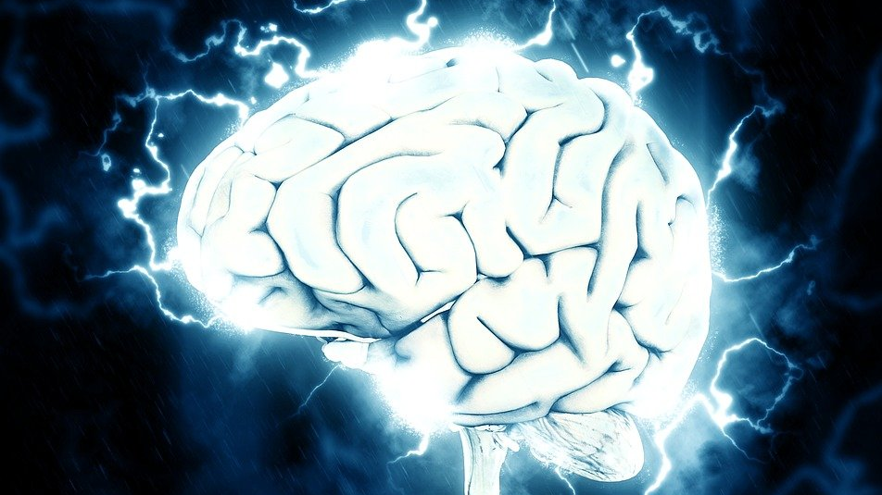
Brain development
Notes:
You may decide to find out from students what they already know here. Or link this to previous work e.g. cells, tissues, organs.

Slide 11
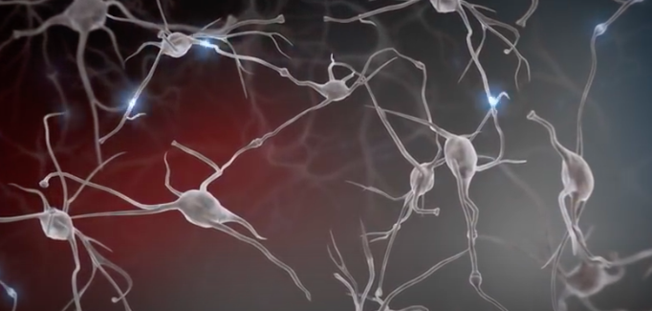
Brain development
Watch the clip about babies’ brains.
Did you know brains grow fastest from 0-2 years!
Afterwards, share 3 new things that you have learnt.
Notes:
Within the 5 year crucial early years period, pregnancy – 2 is when the brain’s growth is fastest.
Pull out the following learning points:
The brain is made up of billions of interconnected neurons.
Genetics and environment (the surroundings and experiences of an individual) both have a role to play in brain development.
Connections between neurons lead to new neural circuits.
Circuits can be strengthened and weakened by individual experiences.
The brain’s growth is fastest 0-2 years.

Slide 12
Watch: Experiences build brain architecture https://www.youtube.com/watch?v=VNNsN9IJkws
Notes:
This video is 1.57 minutes long. It uses animation to show the connection between neurons and the importance of experiences in shaping which circuits are strengthened.

Slide 13
What have you learnt?
The brain is made up of cells called __________.
Brain development is influenced by __________ and ________ factors.
Connections and circuits are strengthened by __________.
The brain grows fastest from ___to ___ years.
In the early years of life, all the ___________ circuits are built.
Challenge: name some of the circuits that grow in the first years of life.
Notes:
There are two versions of the worksheet – a slightly easier version and a harder version.

Slide 14
What have you learnt?
The brain is made up of cells called neurons.
Brain development is influenced by genetic and environmental (experiences) factors.
Connections and circuits are strengthened by experiences.
The brain grows fastest from 0 to 2 years.
In the early years of life, all the simple / foundational /important circuits are built.
Challenge: name some of the circuits that grow in the first years of life.
visual, emotions, motor skills, behavioural control, logic and memory
Notes:
There are two versions of the worksheet – a slightly easier version and a harder version.

Slide 15
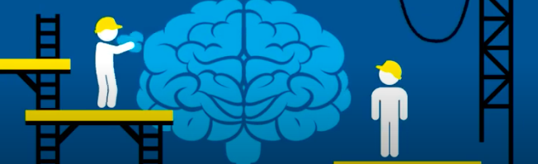
Neuroplasticity
https://www.youtube.com/watch?v=ELpfYCZa87g
Notes:
This video describes briefly (about 2 minutes) what neuroplasticity. Stress with students that whilst genes play an important role in brain development, it is experiences that shape which connections are made between neurons. The brain is a very good example of gene v environment interacations.
Plasticity occurs throughout life, but there are 2 particularly sensitive periods (0-5 and 11-25 years).
There is an extension activity related to epigenetics – the idea that experiences (parenting techniques in rats in this instance) can change the expression of genes and therefore influence brain development.

Slide 16
What have we learnt?
Match the word to their meaning
A - Specialised cell found in the brain.
BRAIN
NEURON
CONNECTIONS
NEUROPLASTICITY
GENES
ENVIRONMENT
B - Junction between two cells. It forms when new experiences occur.
C - The experiences, relationships and surroundings that affect development.
D - The organ of the body responsible for coordinating responses, including thoughts, emotions, and behaviours.
E - Ability of the brain’s structure to change and grow during a person’s life.
F - Unit of inheritance passing from parents to offspring. Determines some characteristics of the offspring.

Slide 17
What have we learnt?
Unscramble the words – and then match to their meaning
F version - answers
D - The organ of the body responsible for coordinating responses, including thoughts, emotions, and behaviours.
BRAIN
NEURON
CONNECTIONS
NEUROPLASTICITY
GENES
ENVIRONMENT
A - Specialised cell found in the brain.
B - Junction between two cells. It forms when new experiences occur.
E - Ability of the brain’s structure to change and grow during a person’s life.
F - Unit of inheritance passing from parents to offspring. Determines some characteristics of the offspring.
C - The experiences, relationships and surroundings that affect development.

Slide 18
Lesson 2: Caregivers and the early years

Slide 19
Learning objectives
Describe the importance of early years development for long term health.
Describe how parents and caregivers can support brain development in the early years.
Notes:
Link with last lesson – genes and the environment influence brain development. This lesson focuses on the environrment. The environment for a child 0-5 is determined by their main caregivers (e.g. parents, carers, child care workers, siblings, close family) . What they do, and the experiences they provide for the child, can greatly influence how the child’s brain develops.
It is a like the interactions between genes and environment for a growing plant – water, CO2, nutrients etc, will all influence how healthy the plant is.

Slide 20

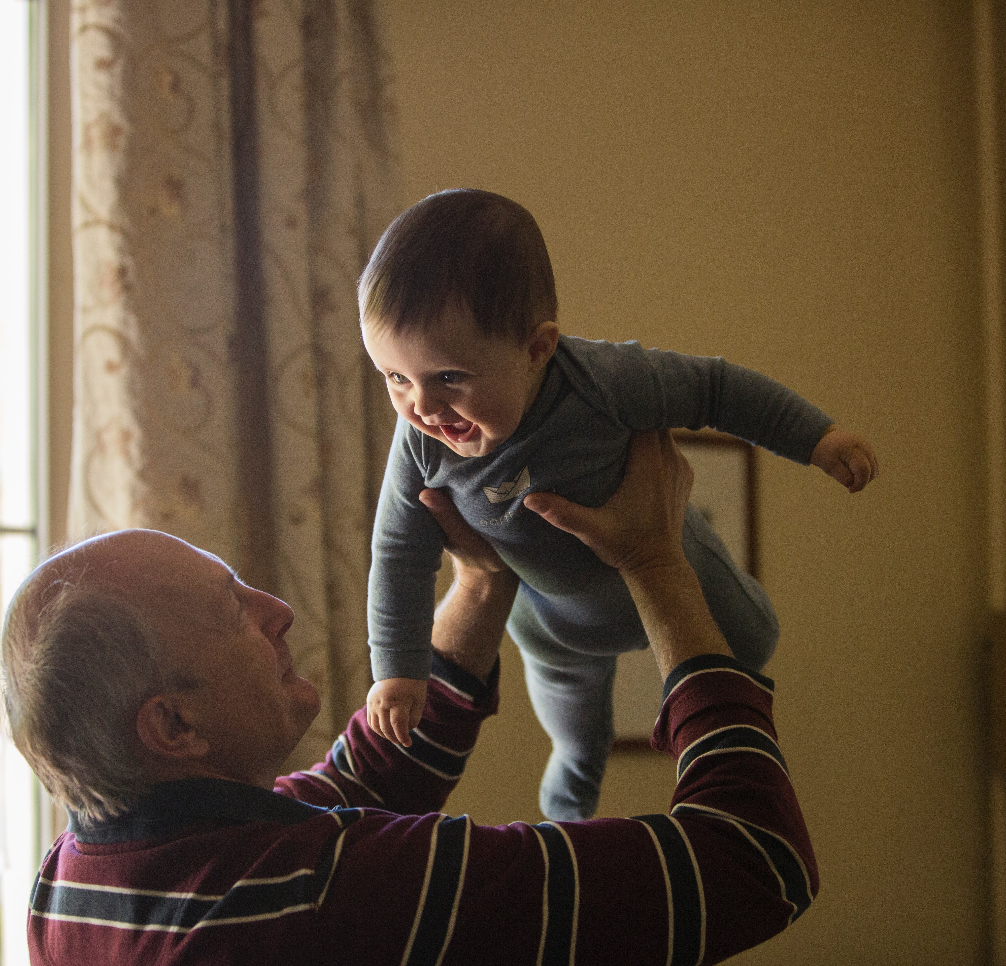
What do caregivers do to promote healthy development from conception (start of pregnancy) to age 5?
For this activity: a caregiver is anybody who is caring for a child (aged 0-5). It could be a parent, grandparent, keyworker, sibling, or friend.
Think and share.
Notes:
Listen to their ideas.

Slide 21

Why is it important? (think back to last lesson!)
The brain grows fastest 0-2.
The environment (and genes) controls how the brain grows.
The caregiver controls the baby’s environment.
Notes:
Link to the prior learning of plants – need appropriate environmental conditions in order to grow into a healthy plant. This lesson looks at the experiences and environmental conditions crucial to healthy child development (long term human health).
The brain grows fastest in the first 2 years of life.
The first 1001 days (pregnancy - 2 years) is critically important for development.
It provides the foundation for physical health and emotional wellbeing.
The brain is rapidly developing during this time and is very sensitive to experiences.
Research has shown that responsive caregiver-infant relationships are very influential during this sensitive period.

Slide 22
What can caregivers do to support child development?
Serve and return interactions:
https://www.albertafamilywellness.org/resources/video/serve-and-return
Baby talk:
https://www.unicef.org/parenting/child-development/baby-talk-class
Playful learning:
https://vimeo.com/505601316/cde3ca6023
Watch the video clips.
What are your tips for caregivers?
Notes:
Additional video if time.
Executive function and self-regulation (optional)
https://www.albertafamilywellness.org/resources/video/executive-function

Slide 23
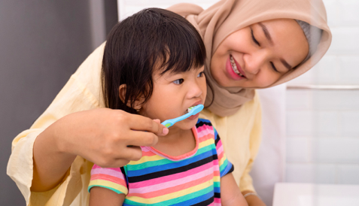
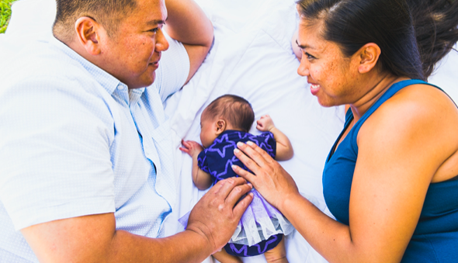
Apply your knowledge
Child observation worksheet

Slide 24
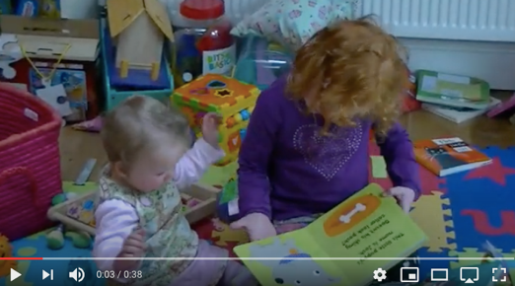
Playful learning child observation
Ooooh, I want to see what’s on the next page!
Imagine what the baby is thinking.
Watch the clip of Iris with her sister Lyra (40 seconds).
Imagine what thoughts are in Lyra’s head (the baby) https://youtu.be/1MHTil5QRf8
Notes:
Research has shown the importance of 'tuning in' to what young children are thinking or feeling (mind-mindedness) and talking out loud to babies about their likely internal states - comments that accurately reflect the infant's thoughts and feelings have been shown to predict wide-ranging positive aspects of children's development. Canadian findings have even shown that mothers' mind-mindedness at the end of the first year of life predicts the functional connectivity of their children's brains at age 10.
One of our pre-pilot teachers found that some students weren’t sure which child they were to imagine thoughts for. Stress that it is THE BABY. In this activity the older child, Iris, is the caregiver. This example is to show that experiences can also be influenced by siblings, it is not always an adult.

Slide 25
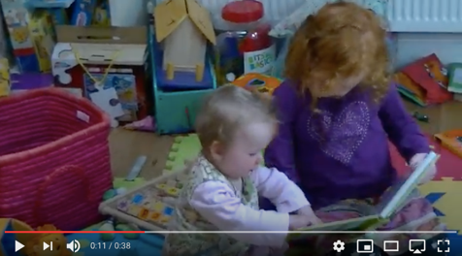
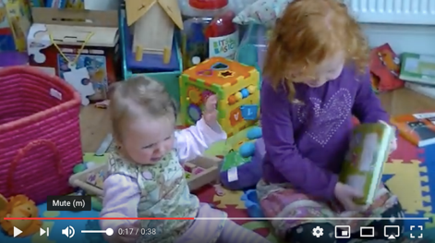
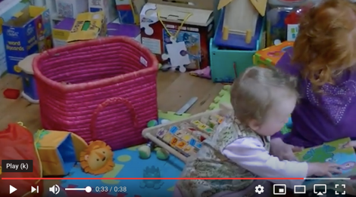
11 seconds
What advice would you give Iris?
17 seconds
33 seconds

Slide 26
11 seconds
”Can I see? Can I have a go? I love this drawing. I wonder what it feels like”.
What advice would you give Iris?
Respond to Lyra e.g. move closer if she wants to see the book.
Notice when she is reaching for the book and let her take it.
Show you are interested, you might say “Oh, would you like to look at the next page Lyra?”..
Move closer so that she can touch the book.
Pass the book to Lyra and help her by holding it on her lap.
17 seconds
“Let me look at the book.
I am so annoyed you won’t share.
If I wave my arms and cry maybe she will realise”
33 seconds
“I want to have a go. That looks like fun. I’m going to try that.”

Slide 27
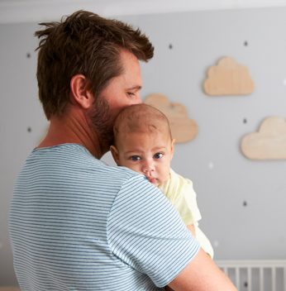


What have you learnt?
What will you do differently next time you interact with a 0-5 year old?
Can you think of 3 things?
Notes:
This activity links to a task the students have to complete on the post-lesson quizzes. Will their learning result in behaviour change?

Slide 28
Lesson 3: Brain development throughout life

Slide 29
Learning objectives
Recognise the importance of early years for long-term health outcomes.
State when brain development is most sensitive to experience.
Describe what can be done to enhance resilience across the life course.

Slide 30
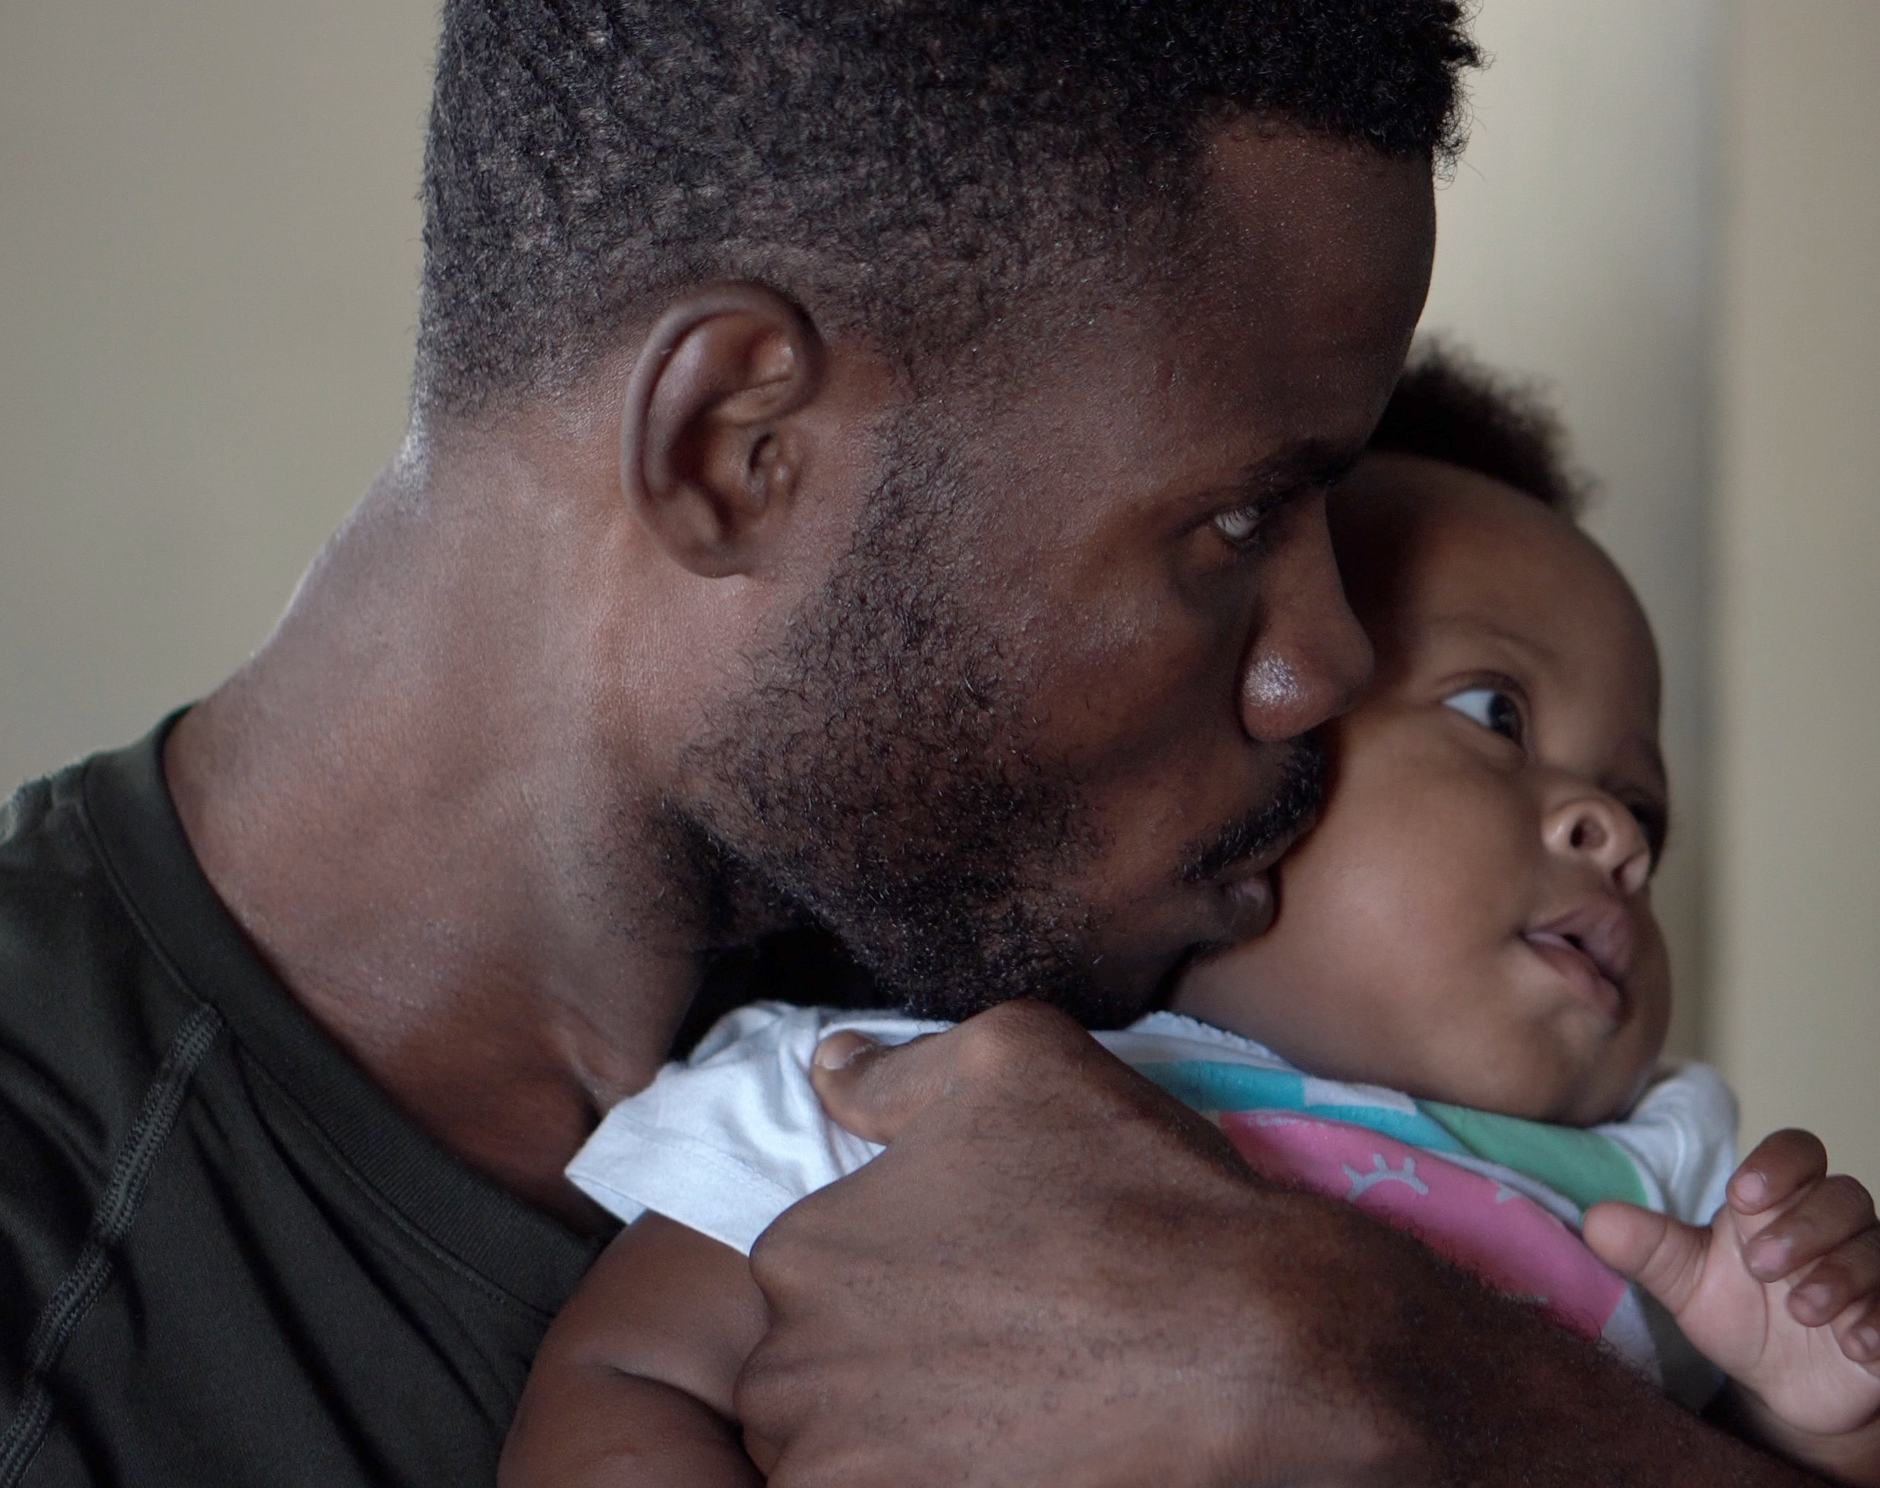
Early years is important for long-term health outcomes.
How do scientists know this?
Notes:
Evidence – investigations
So far we have learnt that:
- the brain is at its most sensitive during the early years
- caregiver interactions with a child can affect early brain development
This lesson we will look at how this impacts later in life.
Scientists use longitudinal studies to investigate the long term impact of interventions. A longitudinal study is a research design that involves repeated observations of the same variables (e.g., people) over short or long periods of time (i.e., uses longitudinal data).
This starter activity looks at data from the ABC study (Carolina Abecedarian Project) which started in the 1970s in North Carolina, USA. The participants were from deprived families and tracked from pregnancy through to adulthood. These results are from 35 years old.
Half the children were randomly assigned to the ‘intervention group’, and half to the ‘control group’.
The intervention group took part in a special childcare programme from the age of 8 weeks until they started school. This treatment involved an educational component involving games which focused on language development, emotional development and cognitive skills. There was a focus on caregivers having intensive one-on-one and small group interactions with the children. There was also healthcare and nutrition support provided as part of the childcare programme.
The Nobel prize winning economist, James Heckman, was also involved with the project and his work demonstrates that the earlier the intervention, the greater the benefit on children’s lives.

Slide 31
The ABC study – an example of the evidence
High blood pressure (% with increased risk of heart attack or stroke)
Which group has the highest risk of high blood pressure at age 35?
Which groups is healthier?
Challenge: what was the difference in the two groups early in their life?
 |  |  | Total
Group A |  |  | 35.5%
Group B |  |  | 16.2%
Control (A) = no intervention
Intervention (B)= a childcare programme (8 weeks post birth until school), including: education, games, one-on-one caregiver attention, health care and nutrition.
Measures taken at age 35.
Source: Campbell et al. Science 28 Mar 2014: Vol. 343, Issue 6178, pp. 1478-1485
Notes:
This is the simplest of the data analysis slides. Point out that this measure was taken at age 35. Much of the evidence to support the importance of early years has been done through longitudinal studies (monitoring people over time). There is a link between early care and physiological changes in the individual, including the stress response. This mechanism explains the difference in hypertension.

Slide 32
Conclusions from research
Caregiver-child relationships are really important and have a life-long impact.
Change is always possible, but it gets much harder as the child gets older.
The brain is very sensitive 0-5 and 11-25, so…
Other factors are also important!

Slide 33
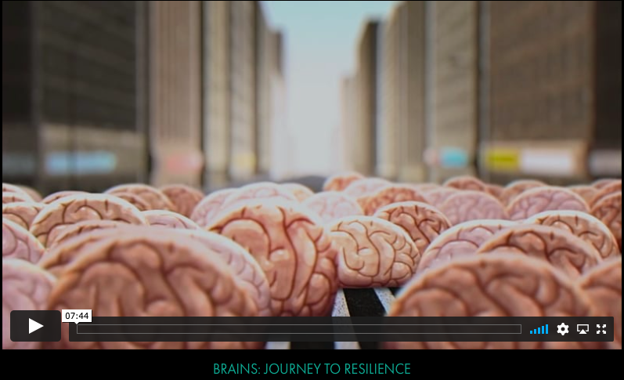
Questions for discussion:
What factors affect brain development?
What is meant by toxic stress?
What is meant by resilience? What can we do to help to build resilience?
When are the brain’s two main periods of sensitivity to experience?
Brains: journey to resilience (7.44)
https://www.albertafamilywellness.org/resources/video/brains-journey-to-resilience

Slide 34
Answers:
Genes and life experiences individuals have; important people in someone's life; strong brain architecture.
When the fight or flight system kicks in and stress hormones (like cortisol) are too high for too long. This is toxic if it has negative effects on development of the brain and body.
The brain's ability to maintain good functioning in the face of serious adversity. Tips the balance towards positive outcomes. Some are born with more resilience than others, but it can also be built over time. To help build resilience we can increase the number of positive experiences in life e.g. responsive relationships and safe environments . We can also try to prevent negative experiences from increasing.
Early childhood (0-5) and adolescence (11 – 25)

Slide 35
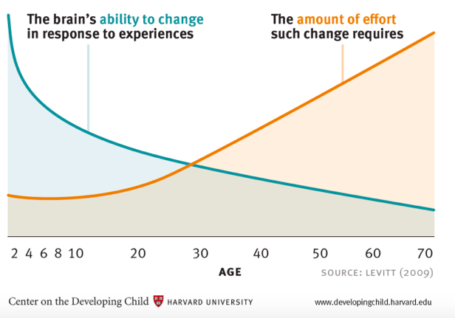
Neuroplasticity over the lifetime

Slide 36
Quiz and evaluation
https://oxford.onlinesurveys.ac.uk/pre-pilot-pupil-survey-post-lesson-

