Slide 1
SEEN Oxford
SEEN Project is a research project run by the University of Oxford and funded by Kindred².
Only a few schools are involved in this research project and your school is one of them!
We hope to inform the future learning of young people across the country... with your help.
So, what's it all about? Before we find out...

Slide 2

Have you completed your pre-lesson quiz?
It would really help us if we could find out what you already know.
It isn't a test. If you don't know the answer, don't guess... just tick the box "I don't know".
This is the link to the pre-lesson quiz:
https://oxford.onlinesurveys.ac.uk/pre-pilot-pupil-survey-pre-lesson

Slide 3
Lesson 1: Brain development in the early years

Slide 4
Learning objectives
Describe the process of brain development
Explain the importance of genetics and the environment in brain development
Define neuroplasticity

Slide 5
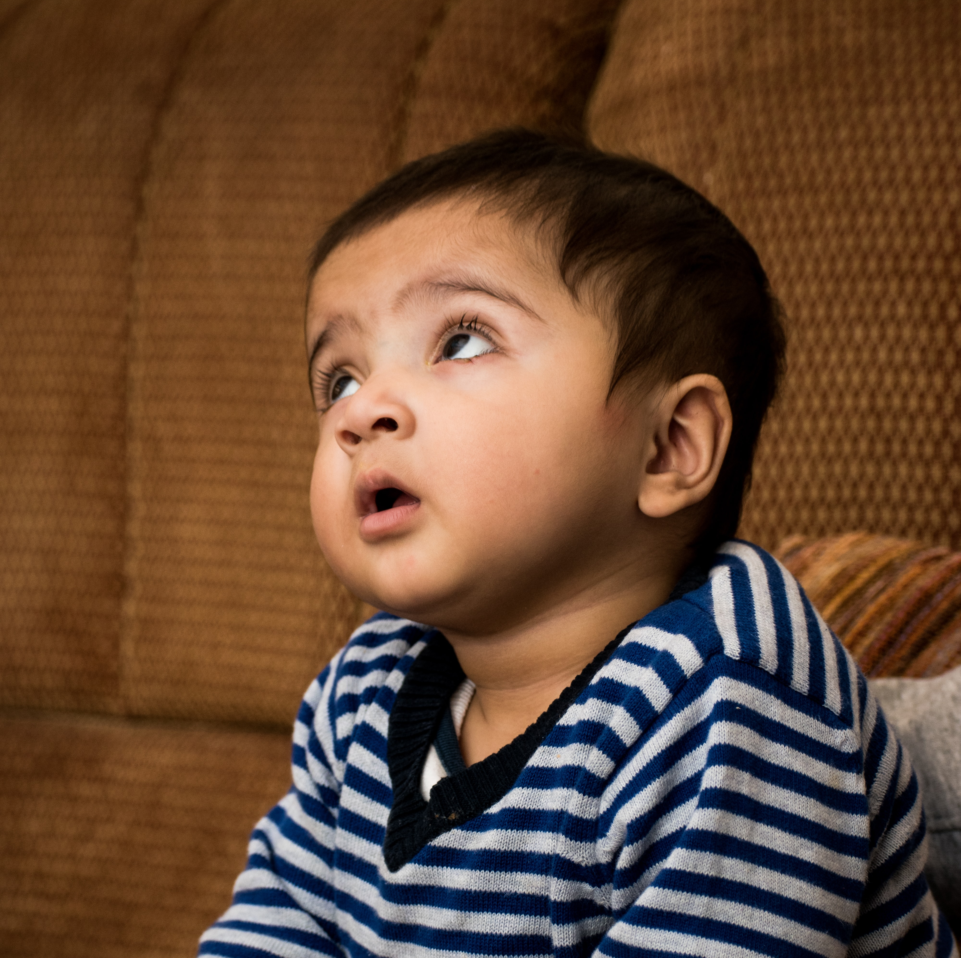
What can babies do?
Which 3 words did you use to describe babies in the pre-lesson questions?
Notes:
Pair then share as a class. What sort of words are they coming up with? Draw out trends… if there are any.

Slide 6

Hands up if...
You have a sibling that is aged 0-5 years
You have regular contact with a child of 0-5 years e.g. a cousin... friend... neighbour.
Notes:
An opportunity to encourage the students to see the relevance to themselves. These lessons are not just about informing future parents… but some of them will be caregivers now (or soon) as siblings / aunties / uncles/ family friends / babysitters.

Slide 7

How much do you really know?
Complete the UNICEF true or false quiz
https://www.unicef.org/parenting/child-development/baby-development-quiz

Slide 8
Answers to the True / False
A baby cannot see and hear at birth. False. Babies can see and hear from birth. Many babies actually remember songs they heard repeatedly while still in the womb!
Before your child speaks, the only way he/she communicates is by crying. False. Babies express themselves in many ways. From laughing and smiling to show enjoyment, to crying and wiggling to show discomfort.
You should talk to your child, even before the child can speak. True. Babies enjoy making new sounds such as squeals and laughs. They learn how to communicate with you even before they can say words.
Your child drops things just to annoy you. False. Children are like little scientists. They want to find out how they can affect people and things around them.
Babies learn better by trying things out and copying others rather than by being told what to do. True. Children learn by playing and trying things out, and by observing and copying what others do.
The brain develops most rapidly when your child first enters school. False. The brain develops most rapidly before birth and during the first two years of life.
Notes:
TAKE HOME message: Babies are individuals in their own right from birth.

Slide 9
What can babies do?
Newborn babies have good senses and prefer their own parent's voice, face and smell over those of strangers
They are born with reflexes e.g. the 'dancing' reflex: when supported on a surface they will make stepping motions with their feet
1 month old babies are better at distinguishing between sounds in foreign languages compared to adults (e.g. babies of English-speaking parents can tell the difference between sounds in Hindi that sound the same to their parents)
6 month old babies can distinguish between a wider range of faces than their parents can (e.g. babies can distinguish between the faces of individual monkeys when adults can't)
Notes:
Additional detail on what babies can do. This slide can be hidden or skipped if you prefer.

Slide 10
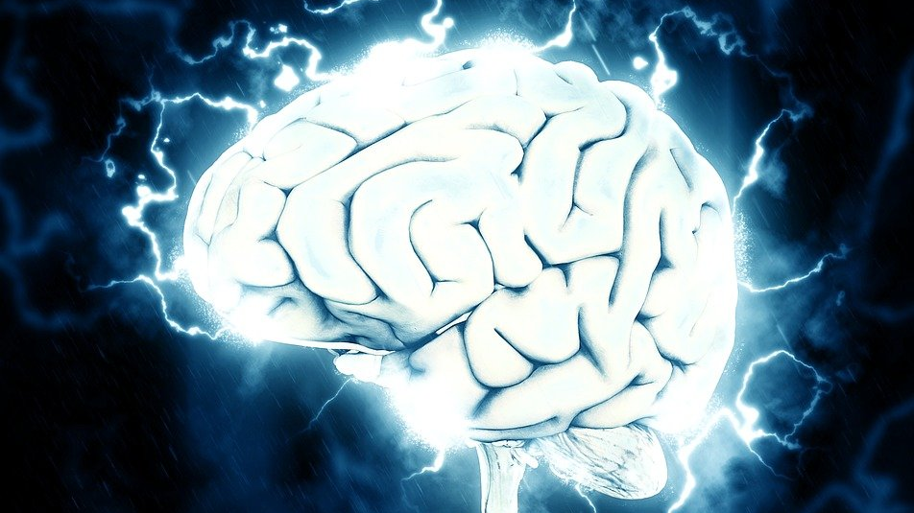
Brain development
Notes:
You may decide to find out from students what they already know here. Or link this to previous work e.g. cells, tissues, organs.

Slide 11
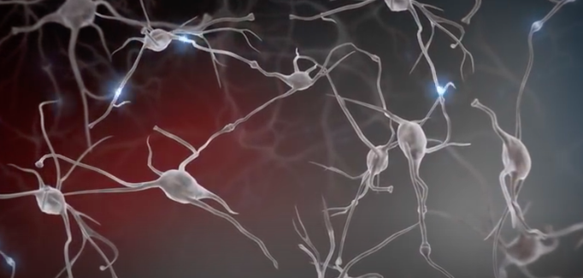
Brain development
The brain is made up of billions of interconnected neurons.
Genetics and environment (the surroundings and experiences of an individual) both have a role to play in brain development.
Connections between neurons lead to the formation of neural circuits.
Circuits can be strengthened and weakened by individual experiences.
The brain’s growth is fastest 0-2 years.
Notes:
Within the 5 year crucial early years period, pregnancy – 2 is when the brain’s growth is fastest.

Slide 12
Watch: Experiences build brain architecture https://www.youtube.com/watch?v=VNNsN9IJkws
Notes:
This video is 1.57 minutes long. It uses animation to show the connection between neurons and the importance of experiences in shaping which circuits are strengthened.

Slide 13
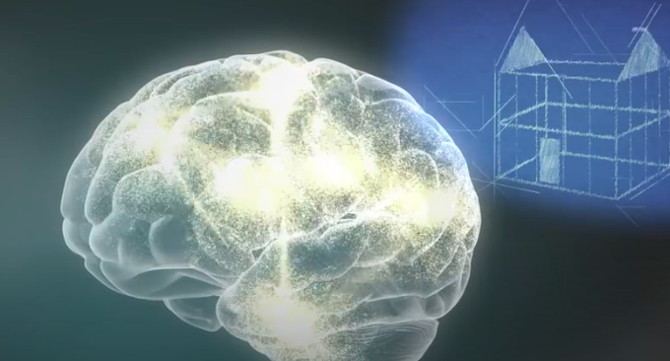
Your task:
Complete worksheet 1.
Watch the video again if you need help.
Notes:
There are two versions of the worksheet – a slightly easier version and a harder version.

Slide 14
Check your work, correct any you got wrong.
Which two factors influence brain development? Genes and experiences (environment).
What are brain cells called? Neurons.
What causes the strengthening of connections and circuits? Repeated use (experiences and environment decides which are used more).
What happens to connections that are not used? Fade away through a process called pruning.
What type of circuits are formed in the early years? Simple circuits or the foundations (visual, emotions, motor skills, behavioural control, logic and memory).
Notes:
These are just the foundation answers.

Slide 15
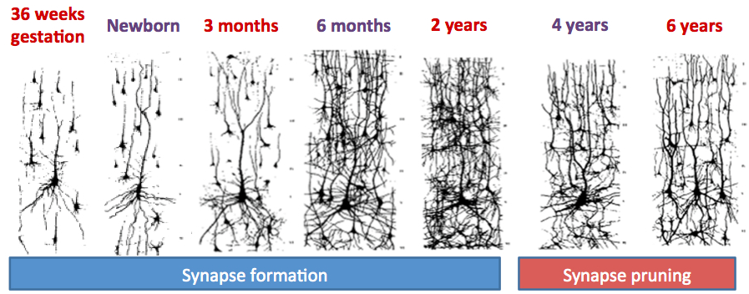
Describe what you see (H):
36 weeks to 2 years the images have an increasing number of neurons (proliferation).
The increase is greatest from 3-6 months.
After two years, the total number of neurons, and connections between neurons, appears to decrease (pruning) between 2-4 years and again 4-6 years.
Notes:
These are the additional question answers from the higher worksheet.

Slide 16
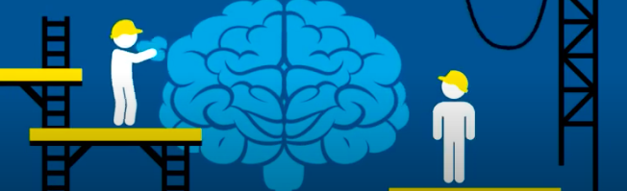
Neuroplasticity
https://www.youtube.com/watch?v=ELpfYCZa87g
Notes:
This video describes briefly (about 2 minutes) what neuroplasticity. Stress with students that whilst genes play an important role in brain development, it is experiences that shape which connections are made between neurons. The brain is a very good example of gene v environment interacations.
Plasticity occurs throughout life, but there are 2 particularly sensitive periods (0-5 and 11-25 years).
There is an extension activity related to epigenetics – the idea that experiences (parenting techniques in rats in this instance) can change the expression of genes and therefore influence brain development.

Slide 17

What have we learnt? Unscramble the words – what do they mean?
NIBAR
ONENUR
NECNOCNOTIS
YELTNOPSCIITAUR
EEGNS
TEVINORMENN
GPINRUN
TSURCIIC
FILOPEARTINOR
NEPICITEGES
H version

Slide 18
What have we learnt? Definitions
BRAIN
NEURON
CONNECTIONS
NEUROPLASTICITY
GENES
ENVIRONMENT
PRUNING
CIRCUITS
PROLIFERATION
EPIGENETICS
H version - answers

Slide 19
BRAIN – The organ of the body responsible for coordinating responses, including thoughts, emotions, and behaviours.
NEURON – Specialised cell found in the brain.
CONNECTIONS – Junction between two cells. It forms when new experiences occur.
NEUROPLASTICITY – Ability of the brain’s structure to change and grow during a person’s life.
GENES – Unit of inheritance passing from parents to offspring. Determines some characteristics of the offspring.
ENVIRONMENT – Experiences, relationships and surroundings that affect development.
PRUNING – Removal of unused connections between neurons
CIRCUITS – Interconnected neurons with a specified function.
PROLIFERATION – Growth or production of new neurons.
EPIGENETICS – Changes in how genes are expressed (or read) cause by environmental factors like experiences.

Slide 20
What have we learnt? Unscramble the words – and then match to their meaning
F version
A - Specialised cell found in the brain.
NIBAR
ONENUR
NECNOCNOTIS
YELTNOPSCIITAUR
EEGNS
TEVINORMENN
B - Junction between two cells. It forms when new experiences occur.
C - The experiences, relationships and surroundings that affect development.
D - The organ of the body responsible for coordinating responses, including thoughts, emotions, and behaviours.
E - Ability of the brain’s structure to change and grow during a person’s life.
F - Unit of inheritance passing from parents to offspring. Determines some characteristics of the offspring.

Slide 21
What have we learnt? Match the word to their meaning
F version
A - Specialised cell found in the brain.
BRAIN
NEURON
CONNECTIONS
NEUROPLASTICITY
GENES
ENVIRONMENT
B - Junction between two cells. It forms when new experiences occur.
C - The experiences, relationships and surroundings that affect development.
D - The organ of the body responsible for coordinating responses, including thoughts, emotions, and behaviours.
E - Ability of the brain’s structure to change and grow during a person’s life.
F - Unit of inheritance passing from parents to offspring. Determines some characteristics of the offspring.

Slide 22
What have we learnt? Unscramble the words – and then match to their meaning
F version - answers
D - The organ of the body responsible for coordinating responses, including thoughts, emotions, and behaviours.
BRAIN
NEURON
CONNECTIONS
NEUROPLASTICITY
GENES
ENVIRONMENT
A - Specialised cell found in the brain.
B - Junction between two cells. It forms when new experiences occur.
E - Ability of the brain’s structure to change and grow during a person’s life.
F - Unit of inheritance passing from parents to offspring. Determines some characteristics of the offspring.
C - The experiences, relationships and surroundings that affect development.

