Slide 1
Lesson 2: Caregivers and the early years

Slide 2
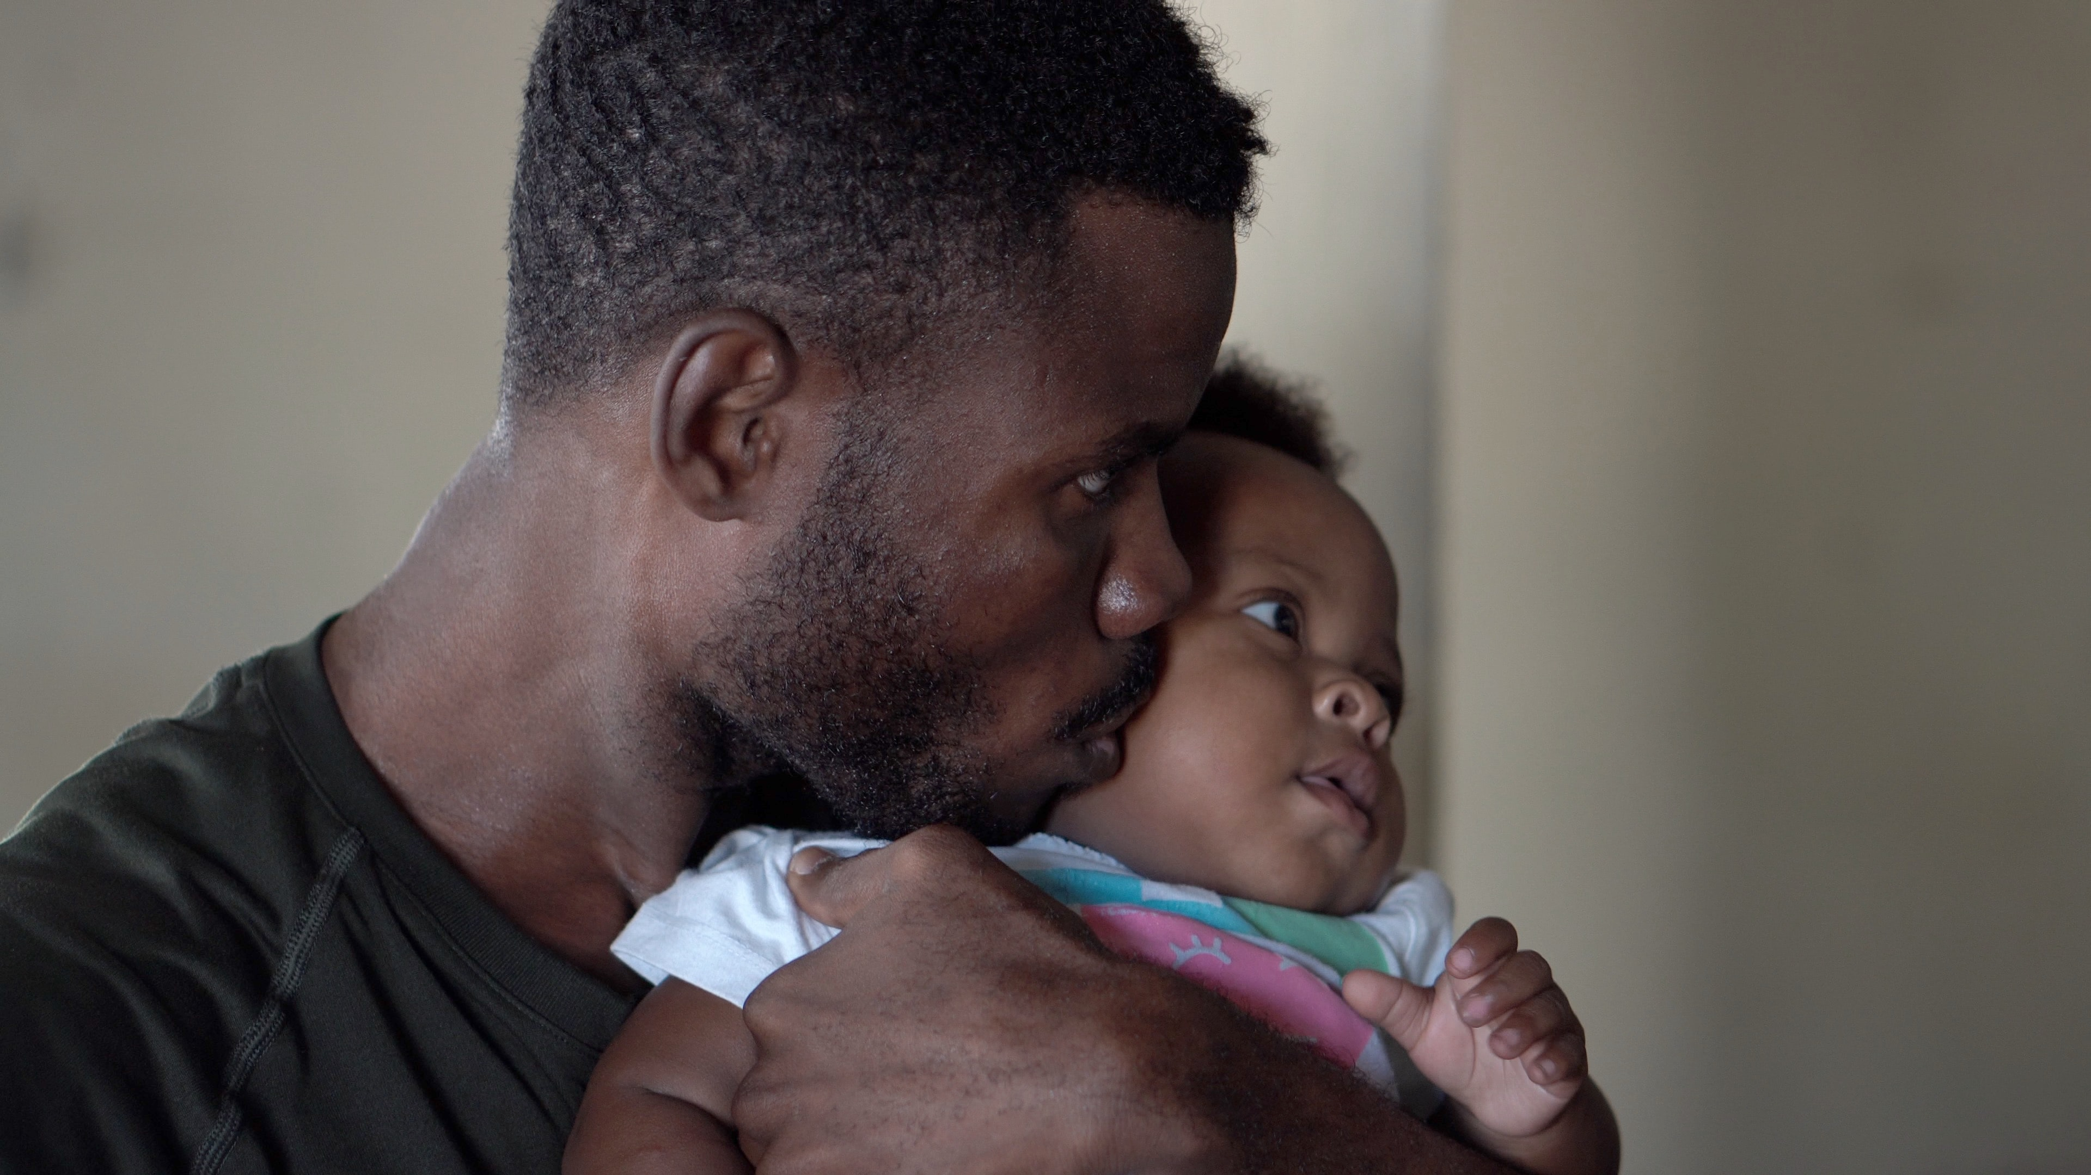
Learning objectives
Describe the importance of early years development for long term health.
Describe how parents and caregivers can support brain development in the early years.
Notes:
Link with last lesson – genes and the environment influence brain development. This lesson focuses on the environrment. The environment for a child 0-5 is determined by their main caregivers (e.g. parents, carers, child care workers, siblings, close family) . What they do, and the experiences they provide for the child, can greatly influence how the child’s brain develops.
It is a like the interactions between genes and environment for a growing plant – water, CO2, nutrients etc, will all influence how healthy the plant is.

Slide 3
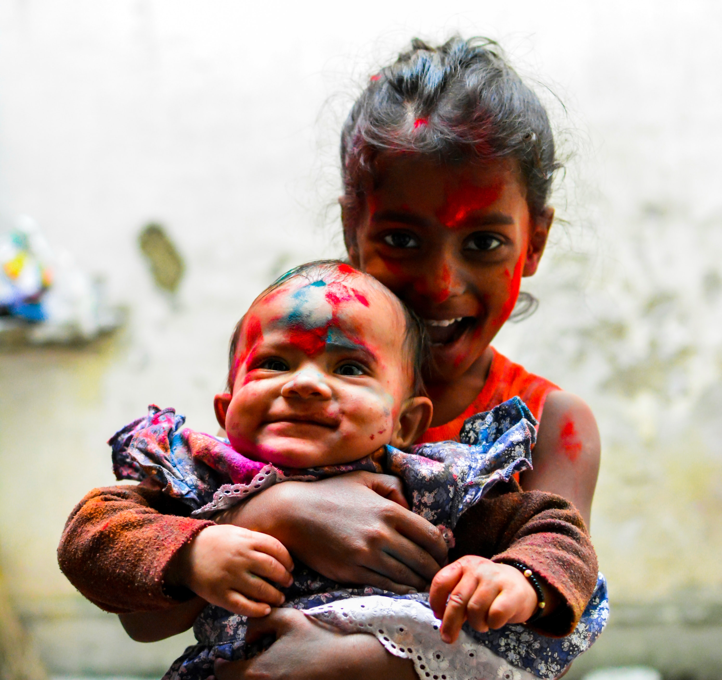
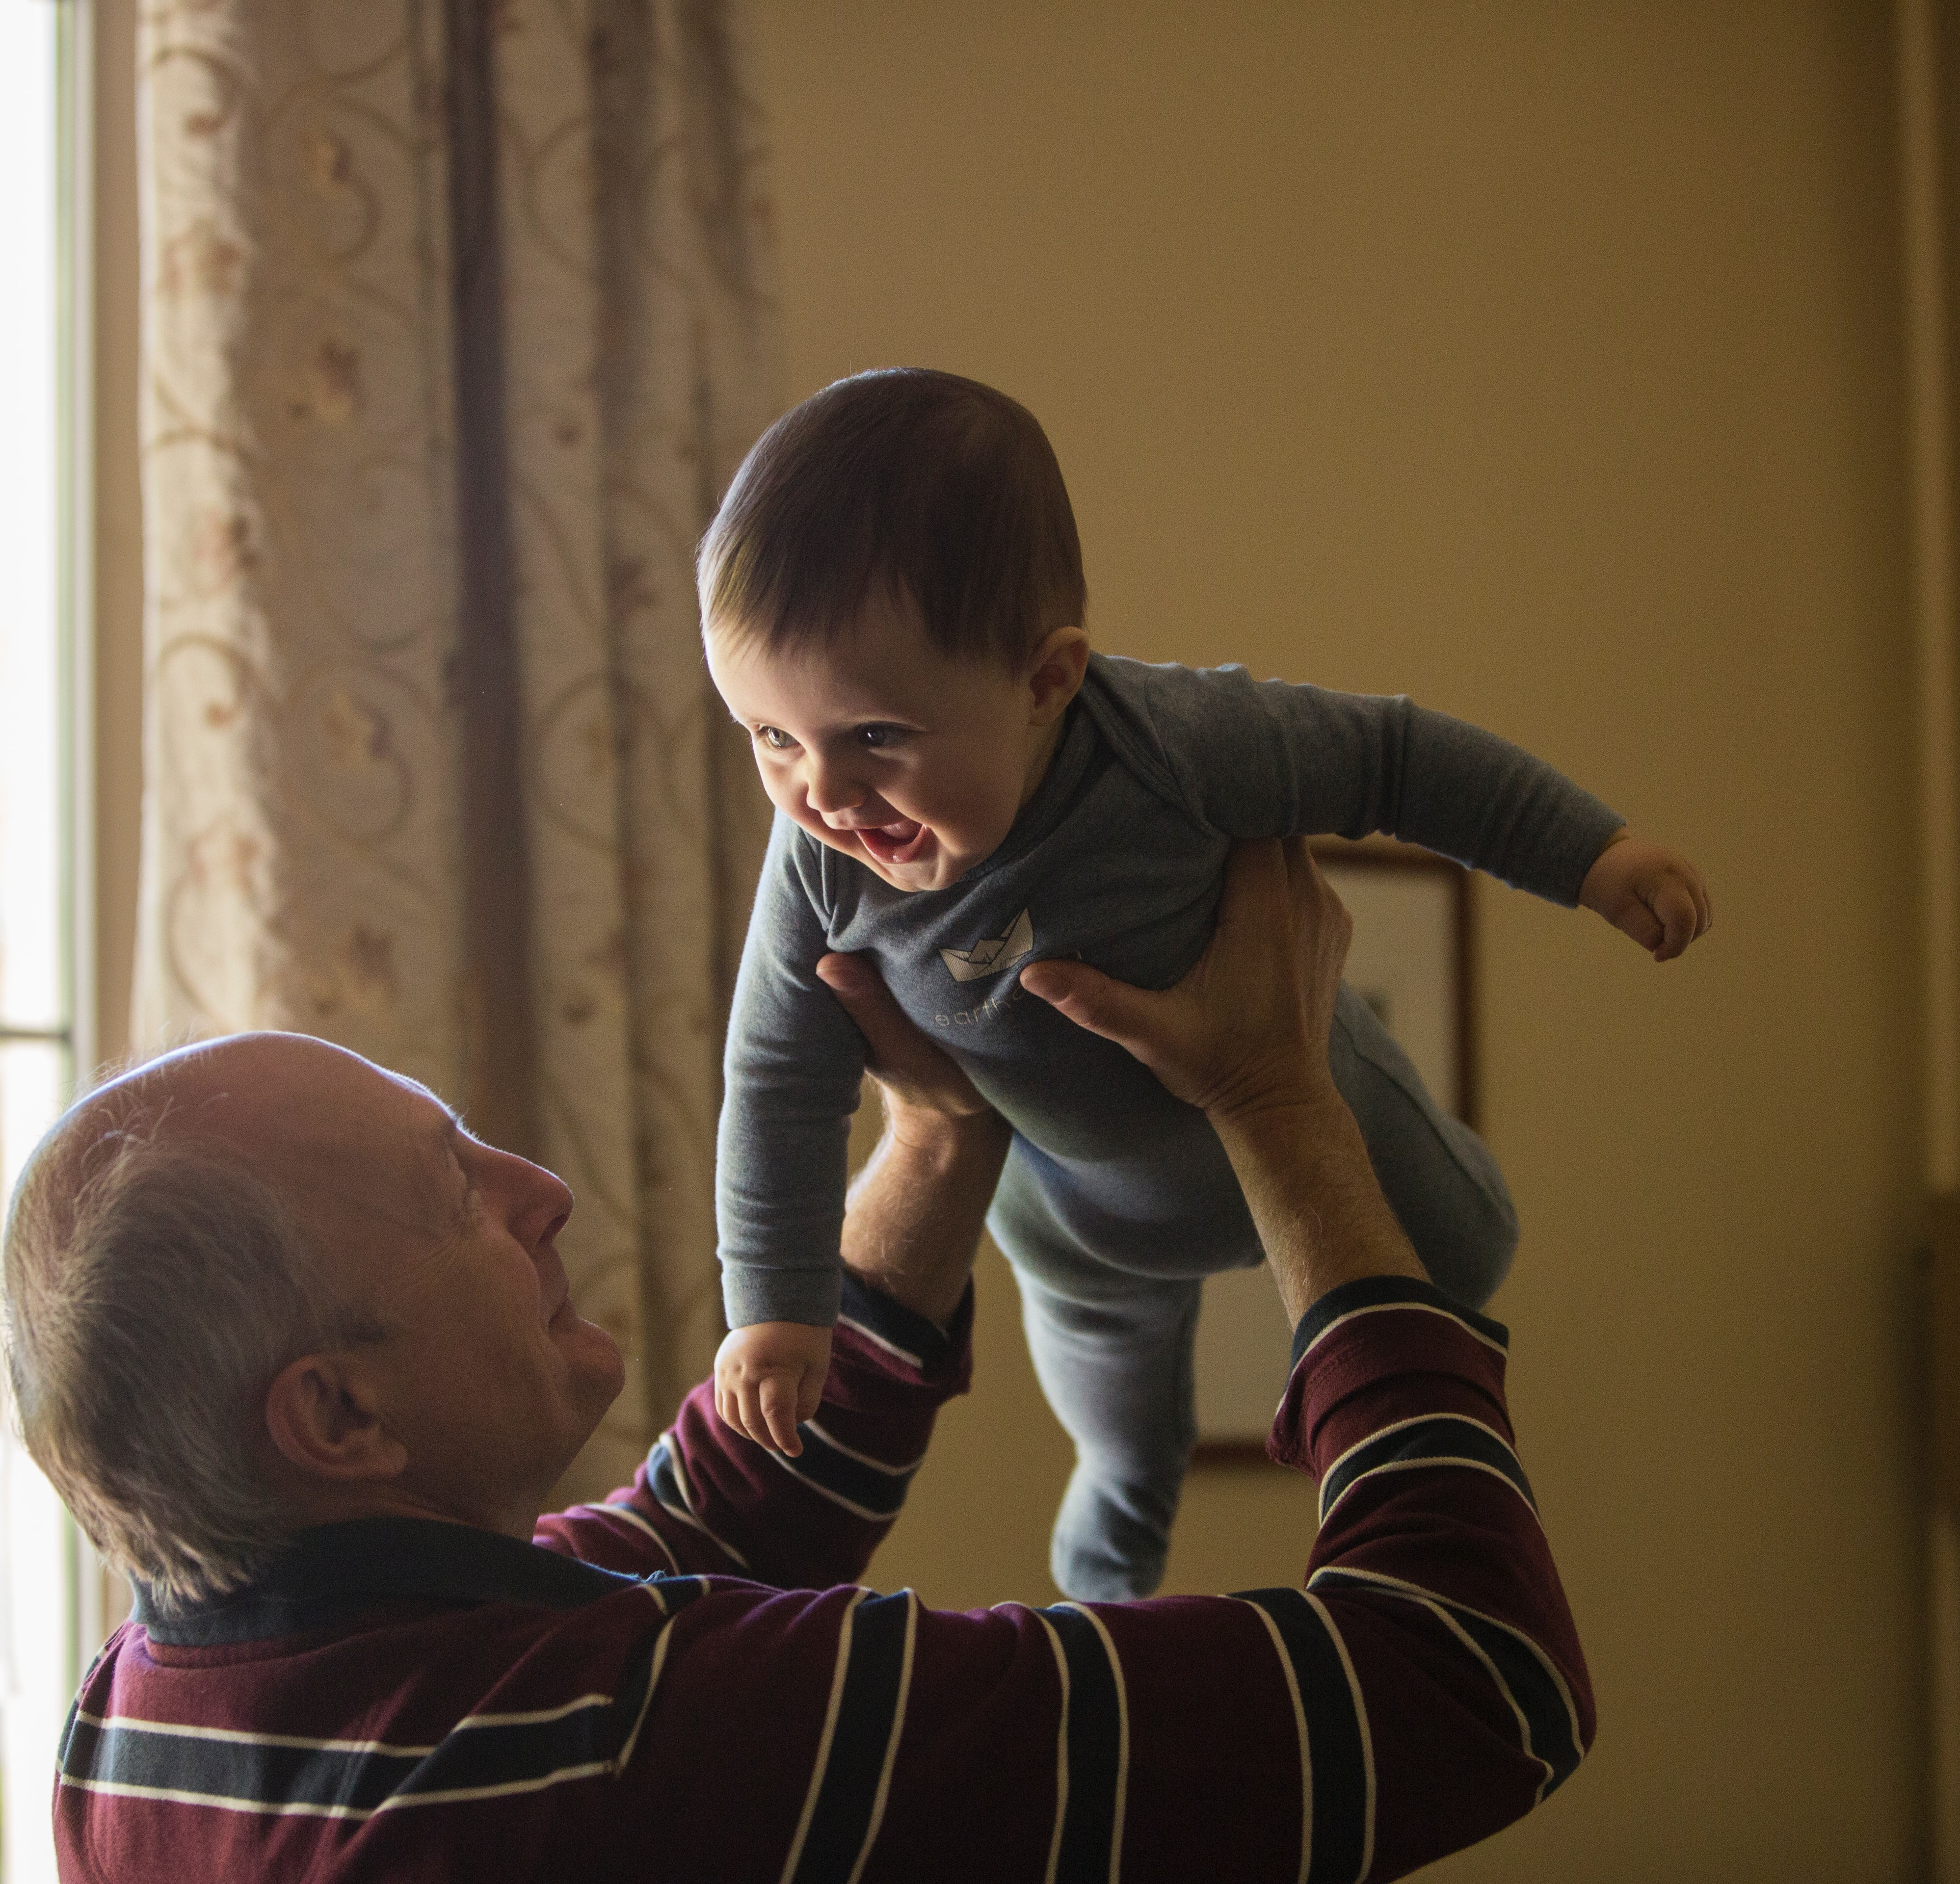
What do caregivers do to promote healthy development from conception (start of pregnancy) to age 5?
For this activity: a caregiver is anybody who is caring for a child (aged 0-5). It could be a parent, grandparent, keyworker, sibling, or friend.
Think and share.
Notes:
Listen to their ideas.

Slide 4

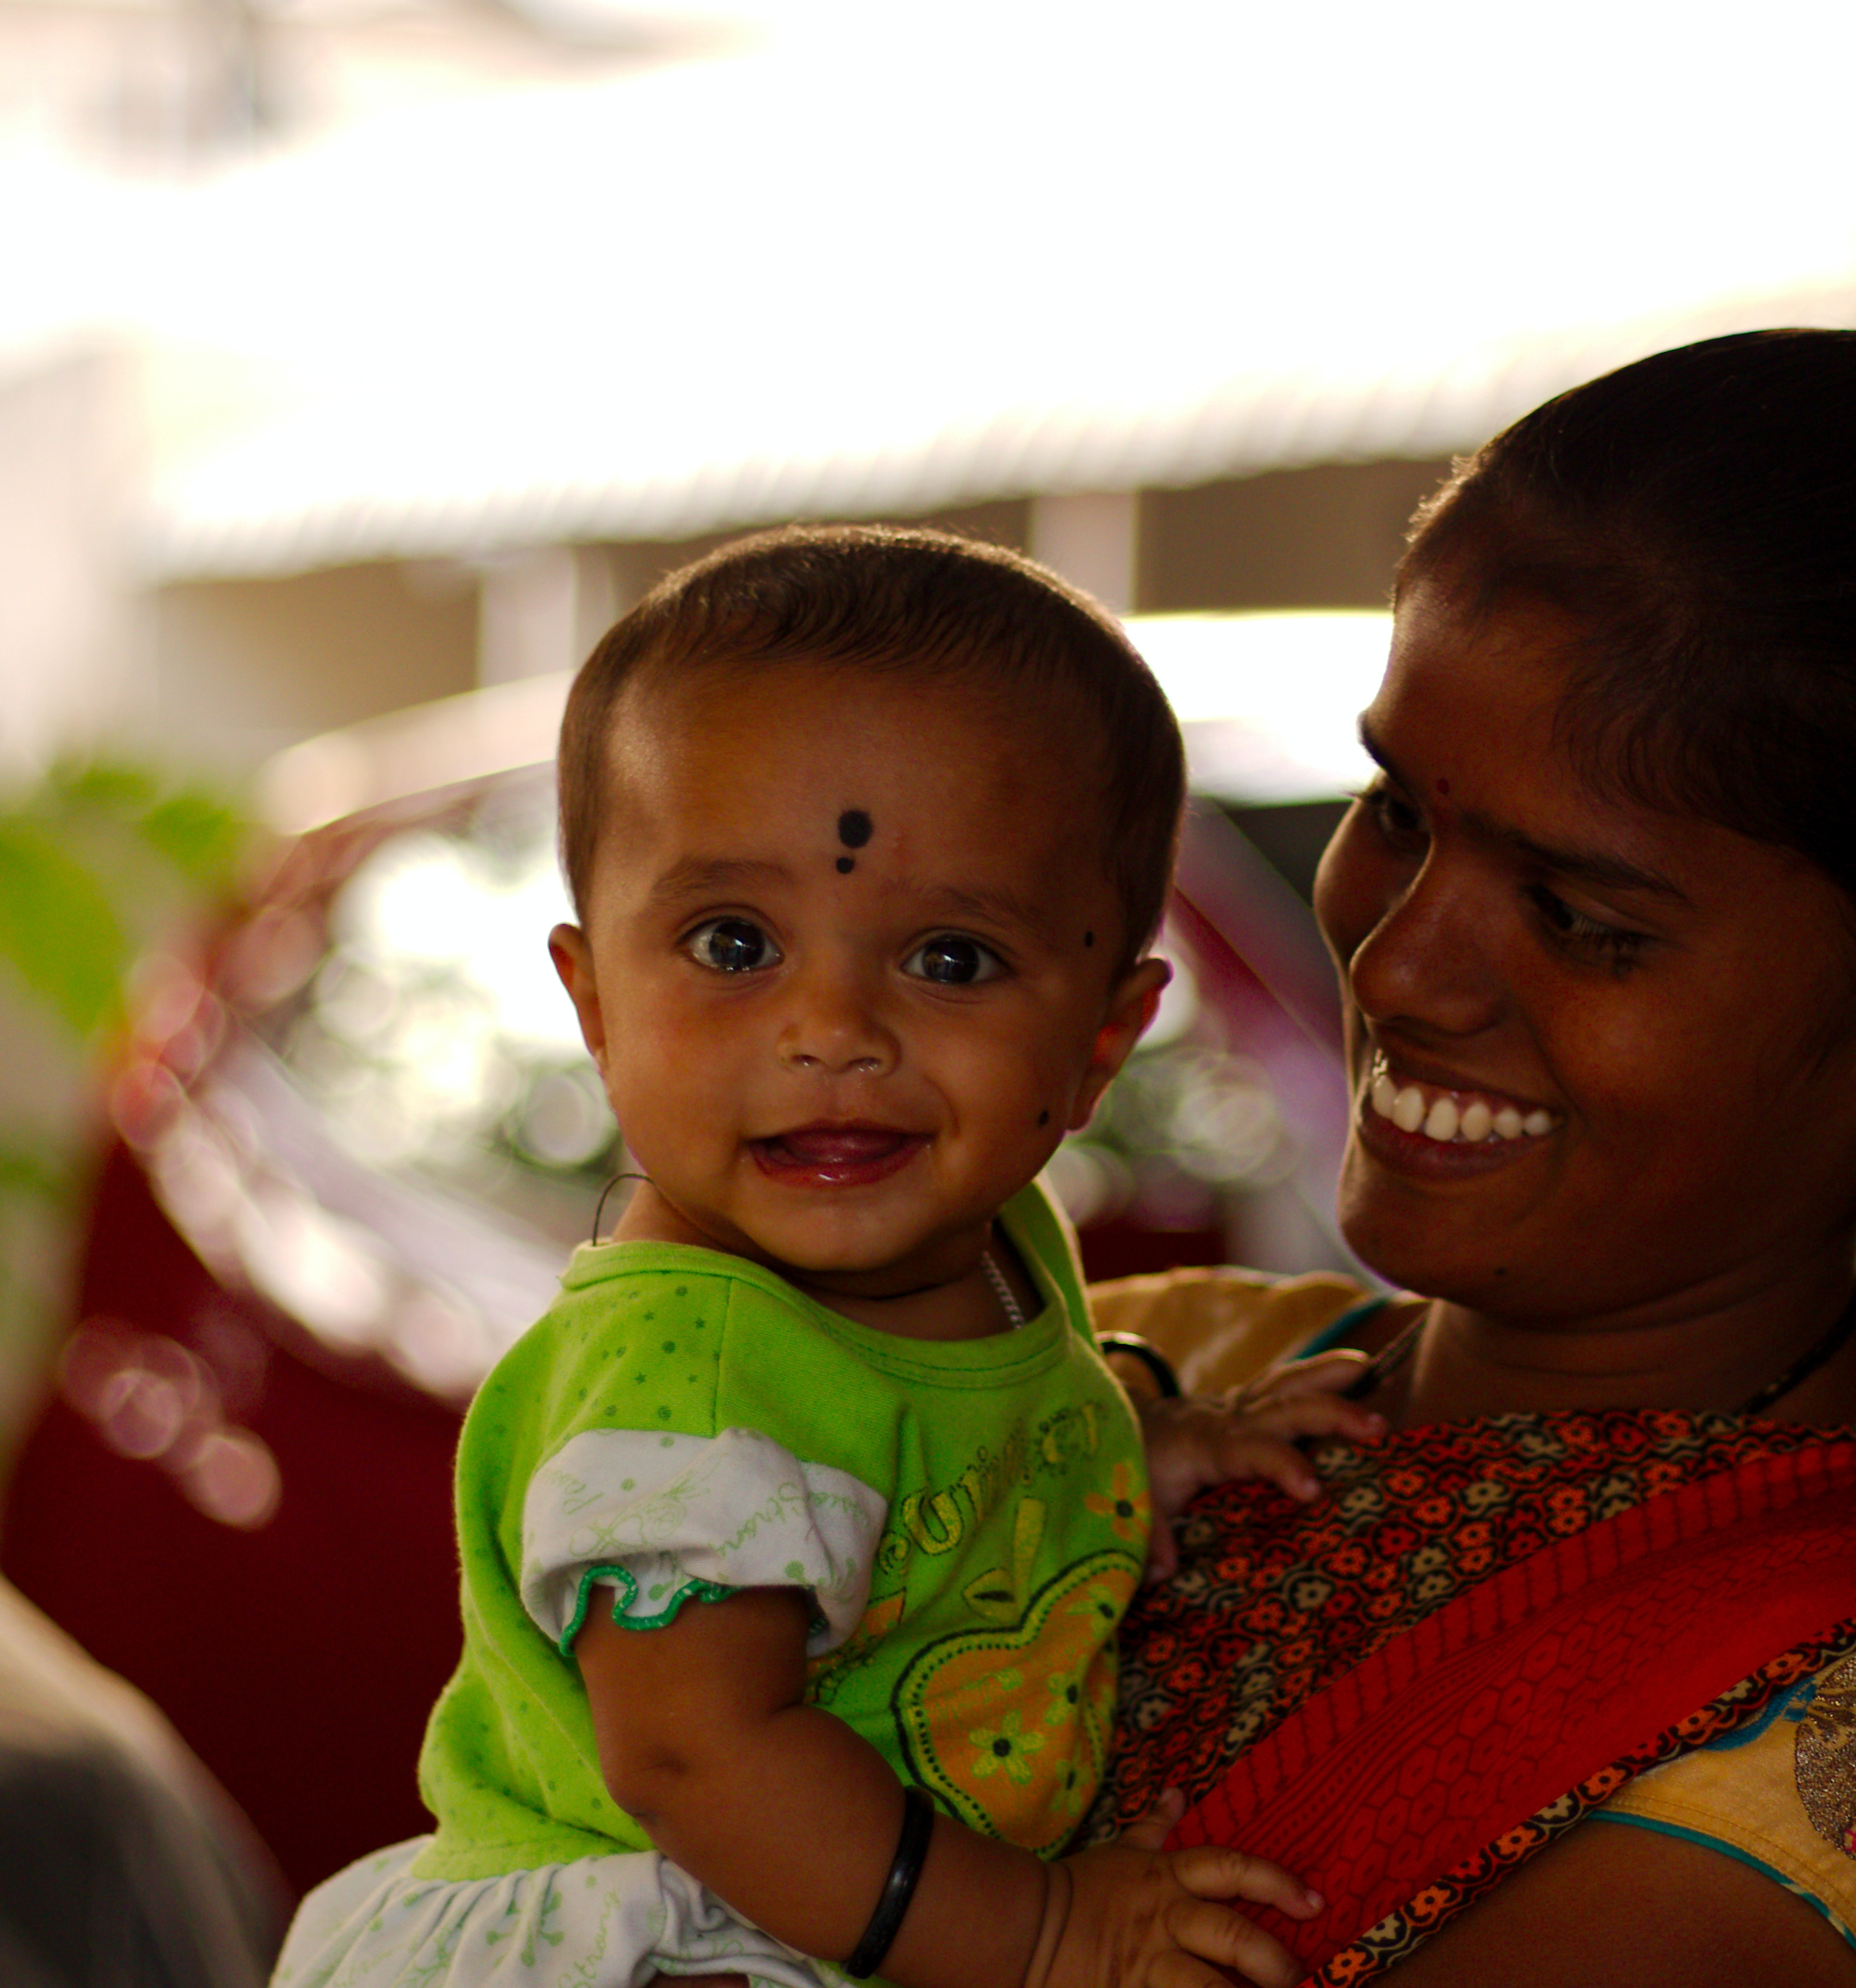
Brain matters video –
5 things parents can do
https://www.youtube.com/watch?v=k1hNZhH9bRg
Optional activity
Notes:
This is an additional video. The aspects covered will be included in the other videos. It could help with repetition if there is time.

Slide 5

Why is it important? Research shows that...
The first 1001 days (pregnancy - 2 years) is critically important for development.
It provides the foundation for physical health and emotional wellbeing.
The brain is rapidly developing during this time and is very sensitive to experiences.
Research has shown that responsive caregiver-infant relationships are very influential during this sensitive period.
Notes:
Link to the prior learning of plants – need appropriate environmental conditions in order to grow into a healthy plant. This lesson looks at the experiences and environmental conditions crucial to healthy child development (long term human health).
The brain grows fastest in the first 2 years of life.

Slide 6
What can caregivers do to support child development?
Serve and return interactions:
https://www.albertafamilywellness.org/resources/video/serve-and-return
Baby talk:
https://www.unicef.org/parenting/child-development/baby-talk-class
Playful learning:
https://vimeo.com/505601316/cde3ca6023
Watch the video clips. What are the main learning points?
Notes:
Additional video if time.
Executive function and self-regulation (optional)
https://www.albertafamilywellness.org/resources/video/executive-function

Slide 7
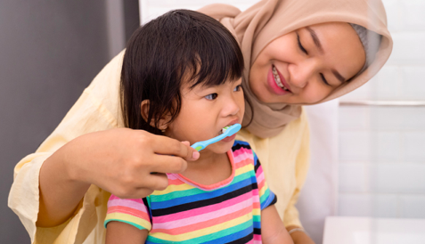
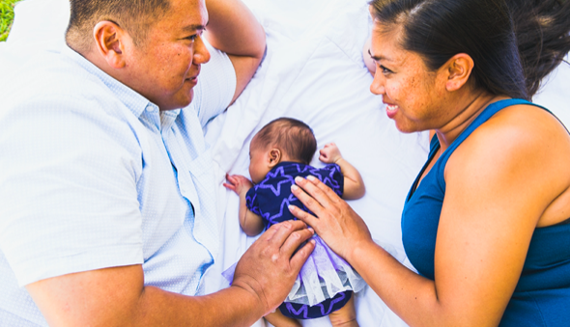
Apply your knowledge
Child observation worksheet
10 top tips for caregivers
Public health leaflet
Researching interactions

Slide 8
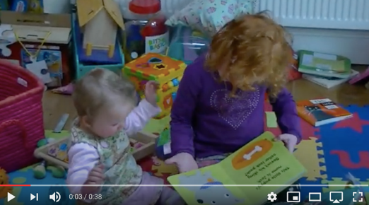
Playful learning child observation
Ooooh, I want to see what’s on the next page!
A good way to develop the skills of a responsive caregiver is to imagine what the child is thinking.
Watch the clip of Iris with her sister Lyra (40s).
Imagine what thoughts are in Lyra’s head (the baby) https://youtu.be/1MHTil5QRf8
Notes:
Research has shown the importance of 'tuning in' to what young children are thinking or feeling (mind-mindedness) and talking out loud to babies about their likely internal states - comments that accurately reflect the infant's thoughts and feelings have been shown to predict wide-ranging positive aspects of children's development. Canadian findings have even shown that mothers' mind-mindedness at the end of the first year of life predicts the functional connectivity of their children's brains at age 10.
One of our pre-pilot teachers found that some students weren’t sure which child they were to imagine thoughts for. Stress that it is THE BABY. In this activity the older child, Iris, is the caregiver. This example is to show that experiences can also be influenced by siblings, it is not always an adult.

Slide 9
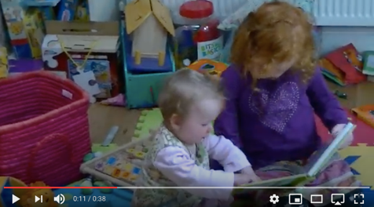
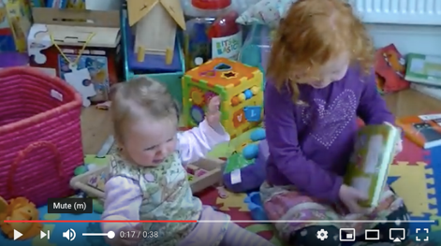
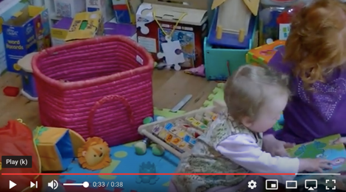
11 seconds
What advice would you give Iris?
17 seconds
33 seconds

Slide 10
11 seconds
”Can I see? Can I have a go? What’s that? Look Iris! I love this drawing. I wonder what it feels like” – Lyra is interested in the book and wants to touch it.
What advice would you give Iris?
Try to respond to Lyra.
Notice when she is reaching for the book and let her take it.
Show you are interested, you might say “Oh, would you like to look at the next page Lyra?” and let her turn the page over.
Move closer so that she can touch and interact with the book.
You could even pass the book to Lyra and help her by holding it on her lap.
17 seconds
“Why can’t I look at the book? I really wanted to have it and Iris won’t let me. It is so frustrating! If I wave my arms and cry maybe she will realise”
33 seconds
“Iris is stroking the book, I want to have a go. Something is moving on the page that looks like fun. I’m going to try that.” Lyra leans forward to touch the book.

Slide 11
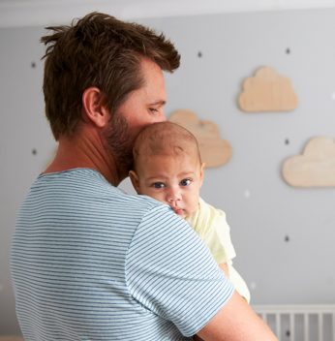
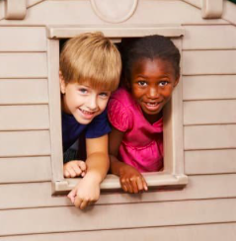
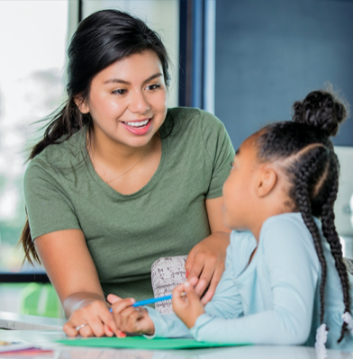
What have you learnt?
What will you do differently next time you interact with a 0-5 year old?
See if you can think of 3 things...
Notes:
This activity links to a task the students have to complete on the post-lesson quizzes. Will their learning result in behaviour change?

