Slide 1
Lesson 3: Brain development throughout life

Slide 2
Learning objectives
Recognise the importance of early years for long-term health outcomes.
State when brain development is most sensitive to experience.
Describe what can be done to enhance resilience across the life course.

Slide 3
Early years is a foundation for long-term health outcomes. How do scientists know this?
Notes:
Evidence – investigations
So far we have learnt that:
- the brain is at its most sensitive during the early years
- caregiver interactions with a child can affect early brain development
This lesson we will look at how this impacts later in life.
Scientists use longitudinal studies to investigate the long term impact of interventions. A longitudinal study is a research design that involves repeated observations of the same variables (e.g., people) over short or long periods of time (i.e., uses longitudinal data).
This starter activity looks at data from the ABC study (Carolina Abecedarian Project) which started in the 1970s in North Carolina, USA. The participants were from deprived families and tracked from pregnancy through to adulthood. These results are from 35 years old.
Half the children were randomly assigned to the ‘intervention group’, and half to the ‘control group’.
The intervention group took part in a special childcare programme from the age of 8 weeks until they started school. This treatment involved an educational component involving games which focused on language development, emotional development and cognitive skills. There was a focus on caregivers having intensive one-on-one and small group interactions with the children. There was also healthcare and nutrition support provided as part of the childcare programme.
The Nobel prize winning economist, James Heckman, was also involved with the project and his work demonstrates that the earlier the intervention, the greater the benefit on children’s lives.

Slide 4
The ABC longitudinal study – an example of the evidence
Look at the data for males:
does the control group or the intervention group have higher risk of heart attack?
What is the difference between the % risk?
What do you think is meant by a longitudinal study?
High blood pressure (% with hypertension and increased risk of heart attack or stroke)
 | Male | Female | Total
Control | 44.4% | 31.8% | 35.5%
Intervention | 10.5% | 22.2% | 16.2%
Control = no intervention
Intervention = a childcare programme (8 weeks post birth until school), including: education, games, one-on-one caregiver attention, health care and nutrition.
Measures taken at age 35.
Source: Campbell et al. Science 28 Mar 2014: Vol. 343, Issue 6178, pp. 1478-1485
Notes:
This is the simplest of the data analysis slides. Unhide the slides below if your group needs something more challenging.
Encourage students to guess the longitudinal study questions. Point out that this measure was taken at age 35. Much of the evidence to support the importance of early years has been done through longitudinal studies.

Slide 5
ANSWERS The ABC longitudinal study
High blood pressure (% with hypertension and increased risk of heart attack or stroke)
 | Male | Female | Total
Control | 44.4% | 31.8% | 35.5%
Intervention | 10.5% | 22.2% | 16.2%
Look at the data for males,:
does the control group or the intervention group have higher risk of heart attack? The control group has a higher risk
What is the difference between the % risk? 44.4-10.5 = 33.9 %
What do you think is meant by a longitudinal study? Participants are followed over time with continuous or repeated measuring.

Slide 6
The ABC longitudinal study – an example of the evidence
What do the results tell you about the impact of early years on adult health?
What do you think is meant by a longitudinal study?
What is a control?
High blood pressure (% with hypertension and increased risk of heart attack or stroke)
 | Male | Female | Total
Control | 44.4% | 31.8% | 35.5%
Intervention | 10.5% | 22.2% | 16.2%
Control = no intervention
Intervention = a childcare programme (8 weeks post birth until school), including: education, games, one-on-one caregiver attention, health care and nutrition.
Measures taken at age 35.
Source: Campbell et al. Science 28 Mar 2014: Vol. 343, Issue 6178, pp. 1478-1485

Slide 7
The ABC longitudinal study – some of the data
High blood pressure (% with hypertension and increased risk of heart attack or stroke)
 | Male | Female | Total
Control | 44.4% | 31.8% | 35.5%
Intervention | 10.5% | 22.2% | 16.2%
1. What do the results tell you about the impact of early years on adult health?
Individuals who had the intervention were less likely to have high blood pressure and therefore had a lower risk of heart attack or stroke (16.2% compared to 35.5% at age 35). This effect was particularly strong in males – 44.4% of the population at risk of high blood temperature compare to 10.5% for males who had the intervention.
2. What do you think is meant by a longitudinal study?
Participants are followed over time with continuous or repeated measuring.
3. What is a control?
The control group is a group of similar participants who are not exposed to the intervention. They are compared to the intervention group to see if there is a difference resulting from the intervention.

Slide 8
The ABC longitudinal study
 | Male | Female | All
Risk of developing heart disease (Higher score = higher risk)
Control | 7.043 | 1.482 | 3.445
Intervention | 4.889 | 1.143 | 3.115
Severe obesity (% of the group with BMI in severe obesity category)
Control | 37.5% | 36.4% | 36.7%
Intervention | 11.1% | 22.3% | 16.5%
High blood pressure (% with hypertension and increased risk of heart attack or stroke)
Control | 44.4% | 31.8% | 35.5%
Intervention | 10.5% | 22.2% | 16.2%
What do the results tell you about the long-term impact of early years interventions on adult health?
What do you think is meant by a longitudinal study?
What is a control?
Intervention = a childcare programme (8 weeks post birth until school), including games which focused on language development, emotional development and cognitive skills; one-on-one caregiver attention, health care and nutrition.
Measures taken at age 35.
From: Campbell et al. Science 28 Mar 2014: Vol. 343, Issue 6178, pp. 1478-1485
Notes:
This is for more able students who are competent at analysing data.

Slide 9
The results of the ABC study show:
Early childhood interventions affect long term health outcomes in adults.
The evidence is particularly strong for men. For example, men in the control group were 4 times more likely to have high blood pressure than the intervention group, at age 35. High blood pressure increases the risk of cardiovascular diseases.
Individuals in the control group had a higher risk of severe obesity, at 36.7%, than the intervention group, 16.5%. (Obesity increases the risk of other diseases such as diabetes, heart disease, stroke, and some types of cancer).
Notes:
There are many other points that can be taken from the data – here are a few examples.

Slide 10
Conclusions from research
Caregiver-child relationships do not determine life’s outcomes, but they are a major influence.
Change is always possible, but it gets much harder as the child gets older.
Other factors must also be important (there is variation in the numbers, not 100% for the control and 0% for the intervention).

Slide 11
Questions for discussion:
What factors affect brain development?
What is meant by toxic stress?
What is meant by resilience? What can we do to help to build resilience?
When are the brain’s two main periods of sensitivity to experience?
Brains: journey to resilience (7.44)
https://www.albertafamilywellness.org/resources/video/brains-journey-to-resilience

Slide 12
Answers:
Genes and life experiences individuals have; important people in someone's life; strong brain architecture.
When the fight or flight system kicks in and stress hormones (like cortisol) are too high for too long. This is toxic if it has negative effects on development of the brain and body.
The brain's ability to maintain good functioning in the face of serious adversity. Tips the balance towards positive outcomes. Some are born with more resilience than others, but it can also be built over time. To help build resilience we can increase the number of positive experiences in life e.g. responsive relationships and safe environments . We can also try to prevent negative experiences from increasing.
Early childhood (0-5) and adolescence (11 – 25)

Slide 13
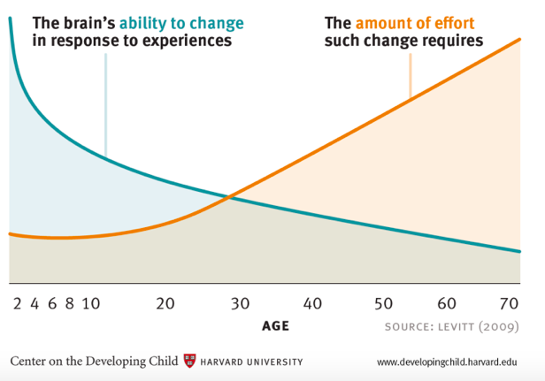
Neuroplasticity over the lifetime

Slide 14
Quiz and evaluation
https://oxford.onlinesurveys.ac.uk/pre-pilot-pupil-survey-post-lesson-

