Slide 1

Screening study
Prevalence of Pathogenic Antibodies in Psychosis (PPiP2)
Objective
To identify SINAPPS2 potential participants through antibody testing of patients with psychosis
Design
Observational cohort study
Over 40 Mental Health Trusts in England and Scotland
Blood sample as soon as possible after diagnosis of psychosis
Live CBA: NMDAR, LGI1, GABA-A and CASPR2
Notes:
We will outline in this short video how you can support recruitment to the PPiP2 study in your Trust.
Our aim is to identify patients in mental health trusts across the UK whose psychosis may be linked a number of pathogenic antibodies. The study involves the collection of blood samples and the use of live cell-based assays to investigate presence of NMDAR, LGI1, GABA-A and CASPR2 anti-neuronal membrane antibodies. Antibody-positive participants might then be eligible for the SINAPPS2 trial investigating immunotherapy for this subpopulation of psychosis patients.

Slide 2
Recruitment Procedure for PPiP2 study
Identify eligible participants
Informed consent
Send blood sample
Notes:
We will explain details recruitment process 1) who is eligible for the study 2) how informed consent is obtained 3) how to safely send the blood sample to us

Slide 3
Assess Eligibility
Inclusion criteria
1. Age 16-60
2. Acute psychosis symptoms (at least moderate)
3. Current episode of psychosis lasting for at least two weeks and less than two years (and at least 6 months remission prior to current episode)
Exclusion criteria
No coexisting neurological disorder (multiple sclerosis, epilepsy, cerebrovascular disease, traumatic brain injury, systemic lupus erythematosus, CNS vasculitis)
Pregnancy
Notes:
Anyone with acute psychosis symptoms should be considered for these antibody tests. However to be eligible for the study they must be aged between 16 and 60 and their current episode should be less than two years.
We can include first episode and recurring psychosis patients. However If they have a history of psychosis, there must be a period of at least 6 months remission prior to their current episode.
We cannot include anyone who is pregnant or has a coexisting neurological condition such as MS, epilepsy or brain injury.
If in doubt –please feel free to contact a member of the research team to discuss.

Slide 4
Acute psychosis symptoms
At least one of the following moderate – very severe symptoms:
Positive
  Delusions
  Conceptual Disorganisation
  Hallucinatory Behaviour
Negative
  Blunted affect
  Passive/Apathetic Social Withdrawal
  Lack of Spontaneity & Flow of Conversation
General symptoms
  Mannerisms & posturing
  Unusual Thought Content
Notes:
We define acute psychosis for the purposes of this study as having at least one of the following symptoms at a moderate to severe level. Ideally patients should be recruited as soon after admission as possible. Please note patients do not require a primary diagnosis of psychosis or schizophrenia or , and patients experiencing mania and depression should also be considered if they are experiencing any of these symptoms.

Slide 5
Approaching potential participants
Provide participant information sheet (PIS)
Assess Capacity
  If patient lacks capacity approach personal consultee e.g. Next of Kin, relative, friend and provide consultee information sheet (PIS for Consultee)
  If no personal consultee can be identified, consider a clinician not involved in the study to act as an professional consultee and provide PIS for Consultee
Notes:
We will send you a localised version of the Participant Information Sheet in your trust. Please offer this to eligible patients and briefly explain the study.
When Assessing capacity please note capacity to consent to this research study may be different to their capacity to consent to treatment and even patients under section may have capacity for the decision.
If they are deemed to lack capacity , you should then approach a personal consultee to provide them with the consultee information sheet. This may be a relative or partner or where there is no one appropriate, a clinician involved in the patients care who is independent from this research study could act as a professional consultee.
.

Slide 6
Consent Process
Consent needs to be obtained by a member of the research team or a clinician with Good Clinical Practice training certificate
Send Patient’s name, DOB, NHS number and patient/consultee contact details to the research team
A member of the research team will contact you when informed consent has been obtained and the blood sample can be collected.
Notes:
Consent must be obtained by someone with NIHR Good Clinical Practice training and therefore you should ask the patient / consultee for permission to pass their contact details to research team.
This might be an identified person in your local research team, or a member of the central study team depending on what has been agreed at your site.
details of the patient including their DOB and NHS number should then be sent to the research team along with contact details for the individual or for their consultee if lacking capacity
consent can be obtained remotely over the phone by a researcher who will contact to let you know when consent has been obtained and the blood sample can be collected.
Please let us know if you are interested in completing the GCP training in order to consent patients for this study.

Slide 7
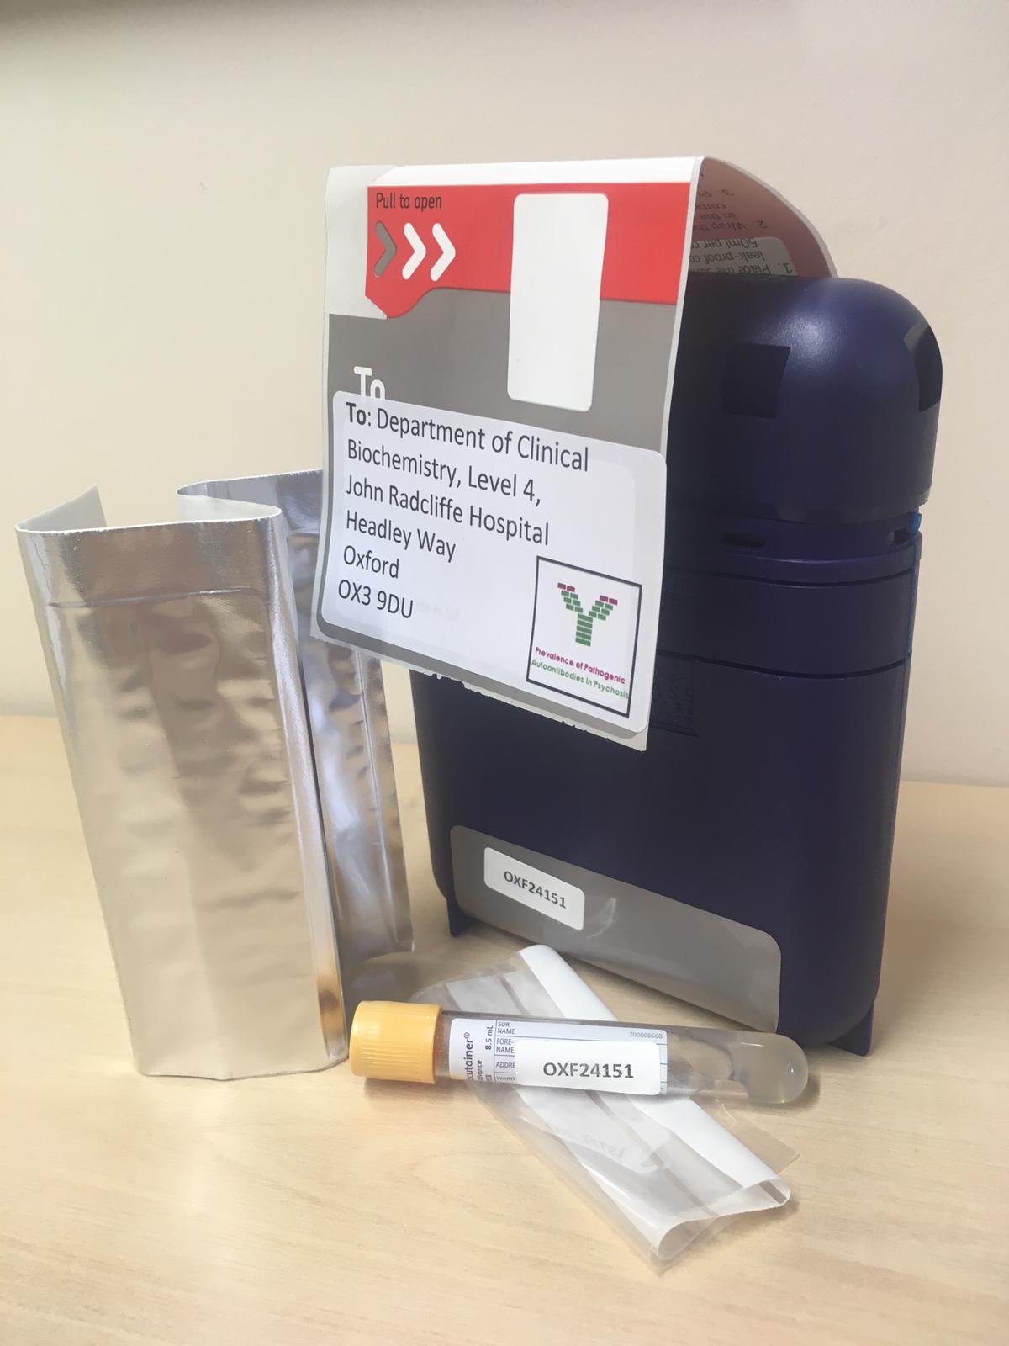
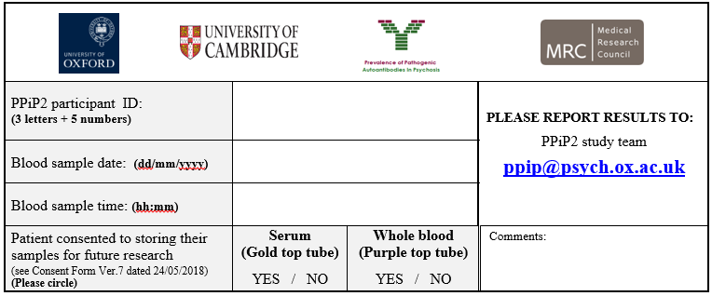
Taking blood samples
1. Order blood kit online
The kits contain
Safe postal box with prepaid postage
Blood tube with allocated ID number
Blood card for writing time and date
Silver pouch with slots for blood tube
Clear plastic bag
Love2shop voucher for participant
2. Take blood
3. Complete Blood Card
4. Give voucher to participant
5. Post the sample in the sealed box
Notes:
The blood sample should be collected as soon as possible after consent has been obtained.
Blood kits can be ordered from the study team free of charge which contain the blood tube and a £10 voucher for the participant. Please give this to them as a thank you for taking part.
There is also a sample card to fill in time and date that the sample was collected.
Each blood kit has an unique ID number which will be on the blood tube and sample card.
There is no need to write patient identifiable data on the card or on the blood tube as we only need the study ID, please remember to make a note of it before sealing the kit.
The sample once collected, should be placed in the silver pouch provided and finally put into the clear plastic bag. The box will seal shut once a white piece of card is removed from the lid, and then the postage sticker can then be unpeeled and wrapped over the top.
This can then be placed in your outgoing post at your place of work or put into any post box.

Slide 8
After taking blood
Email the team with the ID number used and when the sample was sent.
Give completed consent form to participant
Results available in 7-10 days
Ensure results are noted in medical records
Notes:
After taking the sample, please email the person who obtained consent with the study ID number used and the date the sample was sent.
We will send you a copy of the completed consent form to give to participant.
You’ll be notified of the Blood test result within 7-10 days which can then be noted in the patient’s medical record.
.

Slide 9
Summary
Approach eligible participant to assess capacity and interest
Email patient details to researcher who will obtain consent
Take and post blood sample
Provide participant with Voucher
Email researcher again with ID number used and confirmation bloods have been sent
Notes:
To summarise the process, Please approach eligible patients to discuss the study and email contact details to the research team who will obtain consent
Take the blood sample using blue blood kit provided and give the participant the £10 voucher
Send the sealed kit in any post box and finally email the research team to confirm bloods have been sent and which ID number was used.

Slide 10

Contact details
oxfordhealth.ppip@nhs.net
www.sinapps.org.uk
Notes:
Thank you so much for your help with the PPiP2 study. Please do not hesitate to contact a member of the central study team with any questions.

