Slide 1
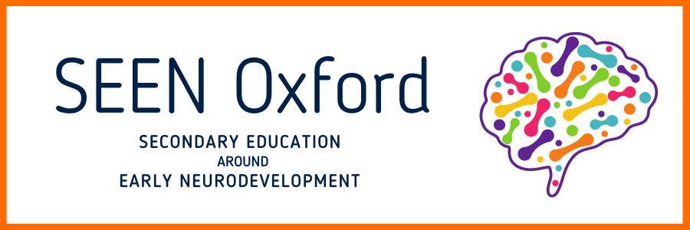


Funders:
Kindred²
Charity working to improve early education and early child development
https://www.psych.ox.ac.uk/research/seen

Slide 2
Training contents:
Project description and rationale
Scientific background
The three lessons
  structure
  content
  differentiation
  knowledge check
Safeguarding
Teacher pack

Slide 3
The SEEN Project rationale and background

Slide 4
What is SEEN?
1 year project
Pilot curricular materials in secondary schools
Academic and Education Expert Advisory Group

Slide 5
Expert Advisory Groups
Academic:
Prof Peter Fonagy
Laura Henry-Allain MBE
Prof Eamon McCrory
Dr Michelle Fernandes
Prof Elizabeth Meins
Dr David Whitebread
Prof Alan Stein
Education:
Thandiwe Banda
John Blake
Adam Boxer
Julian Clarke
Dame Kate Dethridge
Maggie Farrar
Ben Littlewood
Dr Oliver Wimborne

Slide 6
Rationale behind the project
Well established that first 1001 days (pregnancy and first two years of a child’s life) is critically important period
Impacts on long-term health, wellbeing, learning and earnings potential
Sensitive and responsive caregiver-infant relationships pivotal to child’s development
Project aims to target the next generation of caregivers (parents, relatives, key workers, neighbours etc) to equip them for future interactions with young children (aged 0-5)

Slide 7
The evidence base
Longitudinal studies (adverse childhood experiences, trauma, toxic stress)
Longitudinal studies on early years interventions e.g. the ABC study
Neurodevelopmental research (nature of plasticity of the early years)
Cognitive research (e.g. language development, executive function).
Use of technology to investigate links between brain and function e.g. fMRI studies and EEG studies.
Economic analyses of intervention investment e.g. the Heckman Curve.

Slide 8
The lessons…
Lesson 1: Brain development in the early years
- Proliferation and pruning
- Brain architecture
- Neuroplasticity
Lesson 2: Caregivers and the early years
- Playful learning
- Baby talk
- Contingent responsiveness
Lesson 3: Brain development continues throughout life
- Long term health outcomes
- Resilience
- Early years are not deterministic
Not touching upon: - Adverse Childhood Experiences
- Trauma

Slide 9
Research commitment
Student questionnaire 1 (before lesson 1)
https://oxford.onlinesurveys.ac.uk/pre-pilot-pupil-survey-pre-lesson
Student questionnaire 2 (end of lesson 3)
https://oxford.onlinesurveys.ac.uk/pre-pilot-pupil-survey-post-lesson-
Student questionnaire 3 (4 - 8 weeks after lessons)
https://oxford.onlinesurveys.ac.uk/pre-pilot-pupil-survey-follow-up
Teacher questionnaire (after all lessons have been delivered)
https://oxford.onlinesurveys.ac.uk/pre-pilot-teacher-survey
Teacher focus group (optional)
Student focus group (optional)
Examples of student work (optional)

Slide 10
Scientific background

Slide 11
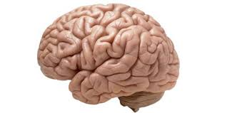
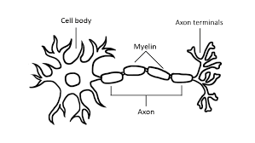
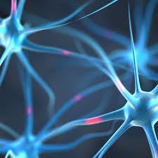
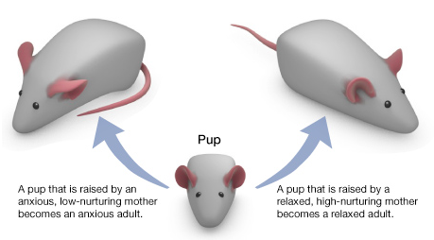
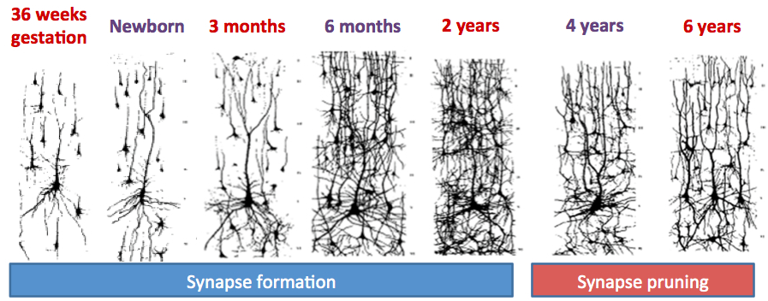
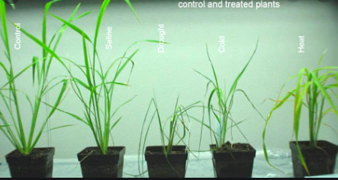
The neuroscience
Proliferation
Pruning
Genes and environment
Neuroplasticity

Slide 12

The brain’s ‘environment’ – role of the caregiver and experiences
Responsive and reciprocal interactions (serve and return)
Playful learning
Developing executive function skills
Baby talk
Good nutrition and a safe environment

Slide 13
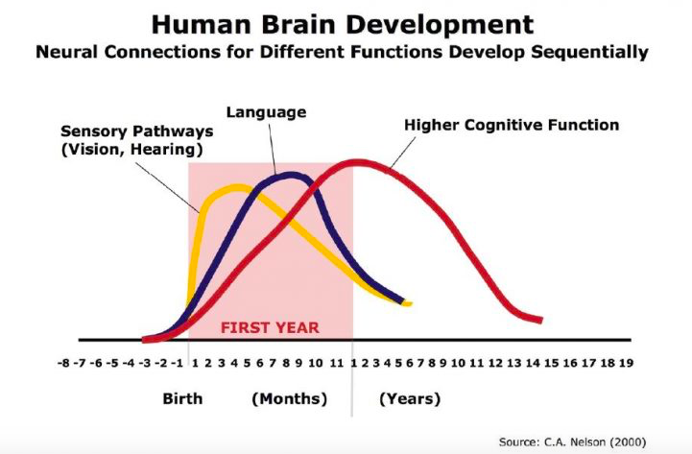
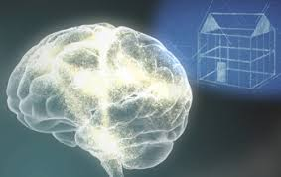
What is the caregiver’s role?
…to provide the experiences

Slide 14
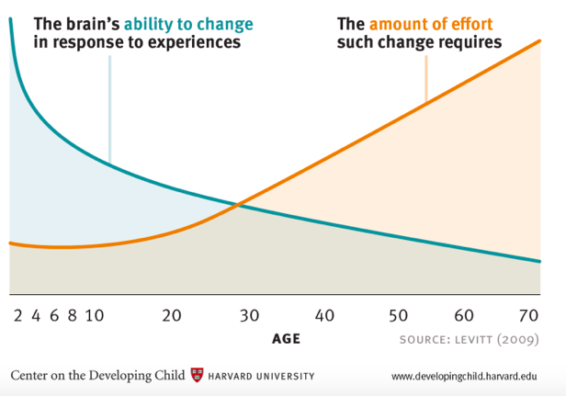
However… it is not deterministic
  The sensitive periods – 0-5, adolescence
  Resilience across a lifetime

Slide 15
The ABC longitudinal study
Intervention = a childcare programme (8 weeks post birth until school), including games which focused on language development, emotional development and cognitive skills; one-on-one caregiver attention, health care and nutrition.
Measures taken at age 35.
 | Male | Female | All
Risk of developing heart disease (Higher score = higher risk)
Control | 7.043 | 1.482 | 3.445
Intervention | 4.889 | 1.143 | 3.115
Severe obesity (% of the group with BMI in severe obesity category)
Control | 37.5% | 36.4% | 36.7%
Intervention | 11.1% | 22.3% | 16.5%
High blood pressure (% with hypertension and increased risk of heart attack or stroke)
Control | 44.4% | 31.8% | 35.5%
Intervention | 10.5% | 22.2% | 16.2%
From: Campbell et al. Science 28 Mar 2014: Vol. 343, Issue 6178, pp. 1478-1485
Notes:
This is for more able students who are competent at analysing data.

Slide 16
Videos to watch
Experiences build brain architecture (2 mins) https://www.youtube.com/watch?v=VNNsN9IJkws
Neuroplasticity (2 mins) https://www.youtube.com/watch?v=ELpfYCZa87g
Responsive interactions (serve and return):
https://www.albertafamilywellness.org/resources/video/serve-and-return
Baby talk (3 mins 13s): https://www.unicef.org/parenting/child-development/baby-talk-class
Playful learning (5 mins, maybe shorter): https://vimeo.com/505601316/cde3ca6023
Executive function and self-regulation (3 mins 52s):
https://www.albertafamilywellness.org/resources/video/executive-function
Brains: journey to resilience (7mins 44s)
https://www.albertafamilywellness.org/resources/video/brains-journey-to-resilience

Slide 17
The 3 lessons

Slide 18
Lesson 1 (following pre-quiz)
Brain development in the early years
What can babies do? Hands up if… video prompt and UNICEF quiz.
Brain development – introduction, video and worksheet, check answers. (H&F versions)
Neuroplasticity – video and definition.
Extension opportunity – epigenetics.
What have we learnt? Key word and definition task. (H&F versions)

Slide 19
Teaching points lesson 1
The brain is made up of billions of interconnected neurons.
Genetics and environment both have a role to play in brain development. (Higher: Epigenetics).
Neural circuits can be strengthened and weakened by individual experiences.
The ability of the brain to change throughout a person’s life is called neuroplasticity.
The brain is particularly plastic, and therefore sensitive to experiences, in the early years (0-5) and adolescence (11-25).

Slide 20
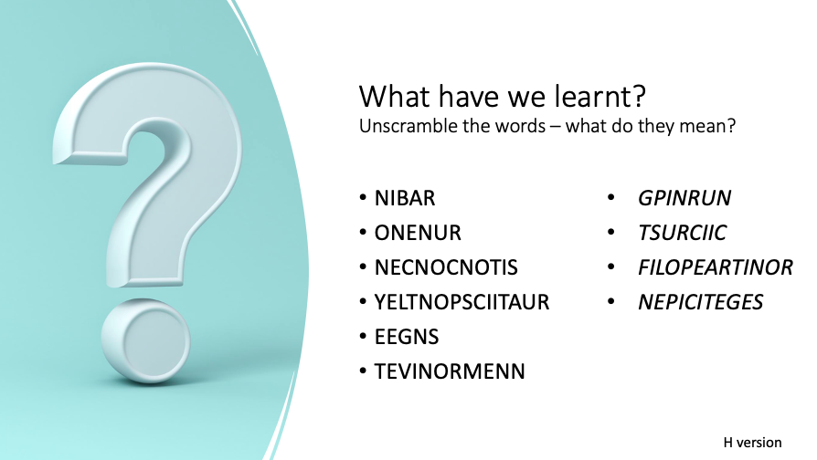
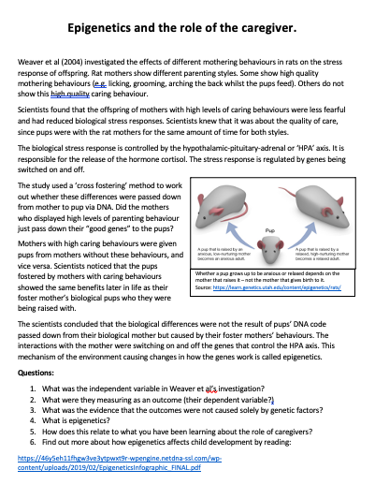
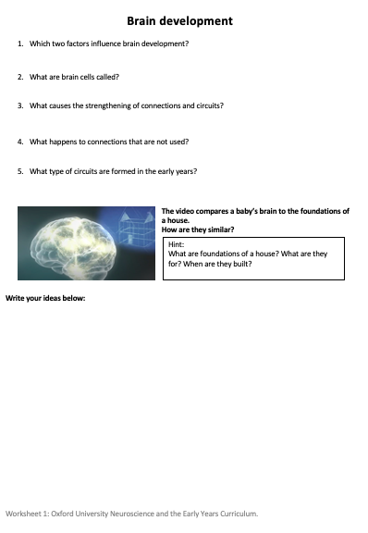
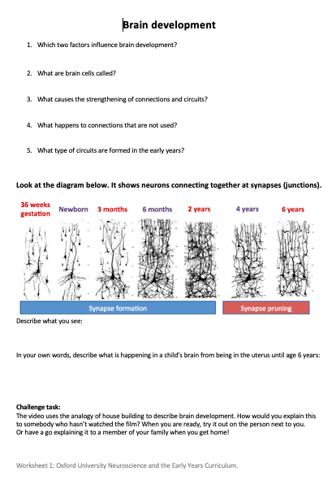
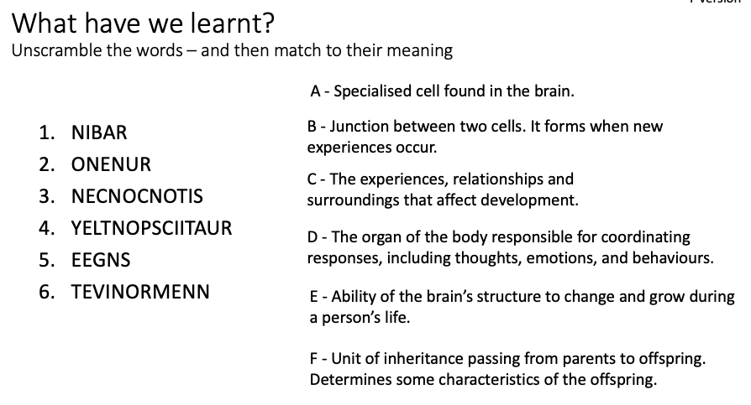
Lesson 1 differentiation

Slide 21
Check your understanding
What is the name of nerve cells in the brain?
Axons
Epithelial cells
Neurons
Lymphocytes
I don’t know.
Which of the following is the best definition of neuroplasticity?
The brain changes in size as a child grows.
The fixed structure of the brain during a person's life, which is not changed by their experiences.
Different parts of the brain are responsible for different functions, tasks or skills.
The brain’s ability to change and grow during a person's life because of their experiences.
I don't know.
How do experiences shape the structure of the developing brain? Select all the answers that are correct.
They increase the number of neurons in the brain.
They influence which neural connections are strengthened and which are pruned away.
They decrease the number of connections between neurons.
They increase the number of connections between neurons.
I don't know.
Which of the following affects how children develop during their first 5 years of life?
A child’s genes.
A child’s environment (where they live, who looks after them and their everyday experiences).
A combination of both their genes and environment.
Neither their genes nor their environment.
I don’t know.

Slide 22
Check your understanding
What is the name of nerve cells in the brain?
Axons
Epithelial cells
Neurons
Lymphocytes
I don’t know.
Which of the following is the best definition of neuroplasticity?
The brain changes in size as a child grows.
The fixed structure of the brain during a person's life, which is not changed by their experiences.
Different parts of the brain are responsible for different functions, tasks or skills.
The brain’s ability to change and grow during a person's life because of their experiences.
I don't know.
How do experiences shape the structure of the developing brain? Select all the answers that are correct.
They increase the number of neurons in the brain.
They influence which neural connections are strengthened and which are pruned away.
They decrease the number of connections between neurons.
They increase the number of connections between neurons.
I don't know.
Which of the following affects how children develop during their first 5 years of life?
A child’s genes.
A child’s environment (where they live, who looks after them and their everyday experiences).
A combination of both their genes and environment.
Neither their genes nor their environment.
I don’t know.

Slide 23
Lesson 2
Caregivers and the early years
What do caregivers do to promote healthy development? Discussion or bullet list. Optional extra video.
3 videos (+1) to watch – notes page, how can caregivers support child development?
Apply knowledge options – specify or give choice (child observation x2, 10 top tips, public health leaflet). Homework or extra lesson.
What have you learnt? 3 things you will do differently the next time you are with a child.

Slide 24
Teaching points lesson 2
Many essential neural circuits are developed in the uterus and throughout the early years.
Babies are able to perceive and discriminate environmental stimuli in the uterus and throughout the early years.
Caregivers can improve long-term health outcomes by supporting brain development through
  Responsive, reciprocal caregiver-child interactions (serve and return),
  baby talk,
  playful learning,
  developing executive function skills.

Slide 25
Getting the young people to apply their knowledge
  Child observation activity
  (mentalising or mind-mindedness)
  Ten top tips
  Researching child-caregiver interactions.
  Public health leaflet

Slide 26
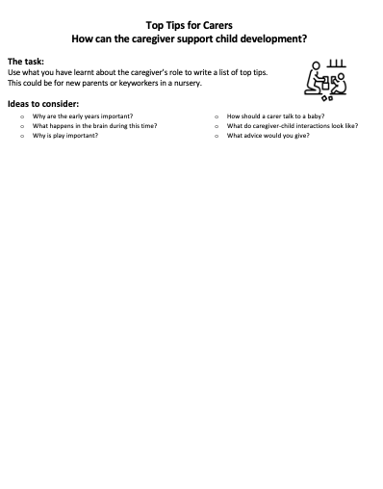
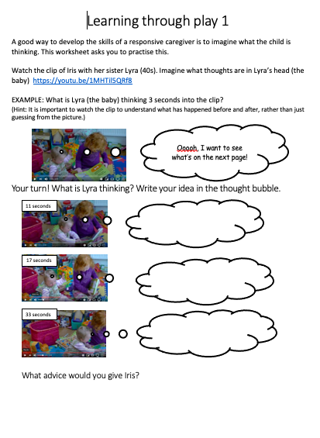
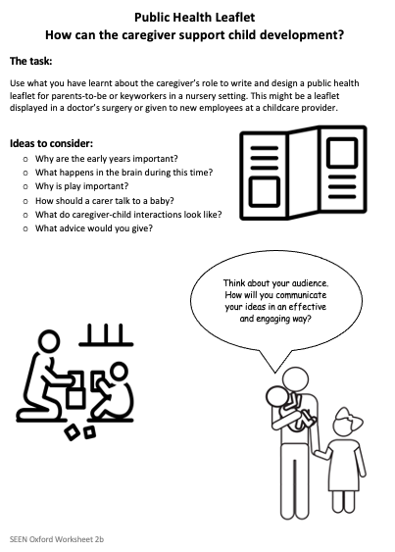
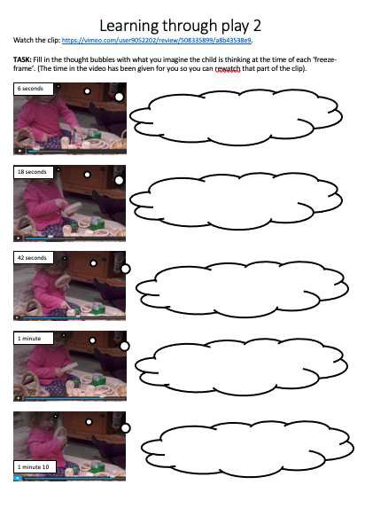
Lesson 2 differentiation

Slide 27
Check your understanding
Why is it important for a caregiver to communicate and respond to their child with their voice, eye contact or touch? Select all the answers that are correct.
It helps the baby's brain to develop and grow.
It develops the relationship between the child and caregiver.
It helps the baby to learn how to concentrate.
It helps the baby to learn about how to take turns.
I don't know.
When do children start playing a role in conversations?
When they are old enough to make recognisable words.
From birth.
When they can speak in whole sentences.
When they start to make babbling sounds (mamama or dada or bububu).
I don't know.
How should a caregiver speak to a baby? Select all the answers that are correct.
They should speak fast.
They should exaggerate their facial expressions (make their facial expressions very clear and obvious).
They should use a sing-song tone of voice.
They should make their speech as complicated as possible.
They should keep repeating the same words.
I don't know.
Imagine you are asked to help look after a friend's 2-year-old child for the day. Explain what you can do to support the child's brain development as you play together. Give three different examples.
(providing the ideal environment for healthy growth)

Slide 28
Check your understanding
Why is it important for a caregiver to communicate and respond to their child with their voice, eye contact or touch? Select all the answers that are correct.
It helps the baby's brain to develop and grow.
It develops the relationship between the child and caregiver.
It helps the baby to learn how to concentrate.
It helps the baby to learn about how to take turns.
I don't know.
When do children start playing a role in conversations?
When they are old enough to make recognisable words.
From birth.
When they can speak in whole sentences.
When they start to make babbling sounds (mamama or dada or bububu).
I don't know.
How should a caregiver speak to a baby? Select all the answers that are correct.
They should speak fast.
They should exaggerate their facial expressions (make their facial expressions very clear and obvious).
They should use a sing-song tone of voice.
They should make their speech as complicated as possible.
They should keep repeating the same words.
I don't know.

Slide 29
Imagine you are asked to help look after a friend's 2-year-old child for the day. Explain what you can do to support the child's brain development as you play together. Give three different examples.
Be curious about what is catching the baby/child’s interest and attention. Label things out loud.
Show babies/children that you are interested in their activities through your eye gaze, voice and actions.
Use serve and return interactions (contingent responsiveness).
Let the child explore and play independently in a safe environment.
Describe out loud what the child is doing or might be thinking.
Extend play through suggestions that respond to the child’s interest.
Read with the baby/child in a way that encourages interactions around the story.
Use baby talk - sing song voice, exaggerate facial expressions, repetition, simplified language. when interacting with a baby.
Take part in make believe play.
Give the child an opportunity to learn executive function skills such as planning, organising, decision making.
Avoid using devices (e.g. phone) all the time when with the baby / child.
Keep the child safe (or examples of how this can be done).
Provide the child with good nutrition.
Reduce toxic stress (prolonged adversity) wherever possible.

Slide 30
Lesson 3
Brain development throughout life
Evidence shows importance but not deterministic. 3 questions on the evidence, longitudinal studies and control (H&F options).
Video – (7.44 mins) followed by questions for discussion or completing.
Discussion – neuroplasticity over time.
(Extension – epigenetics, from lesson 1)
Quiz and evaluation – online repeat of the quiz, with some additional evaluation questions.

Slide 31
Teaching points lesson 3
The early years period is a foundation for long term physical and mental health (evidence base for this).
What happens in the early years is not deterministic.
Resilience is dependent on supportive relationships and developing skills.
Revisit: The brain is particularly plastic, and therefore sensitive to experiences, in the early years (0-5) and adolescence (11-25).

Slide 32
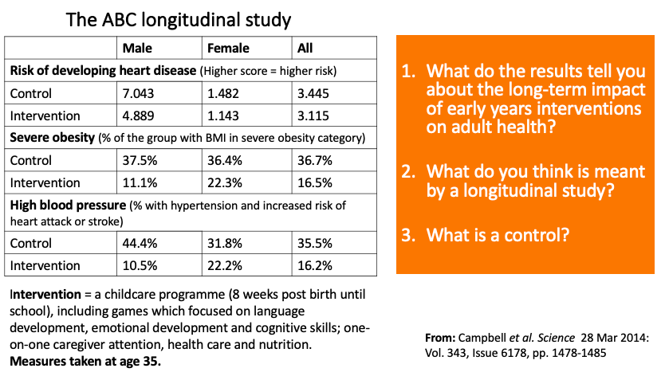
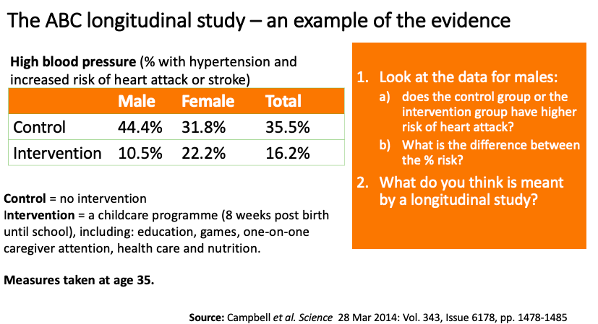
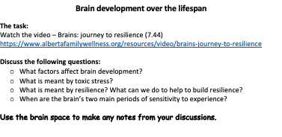
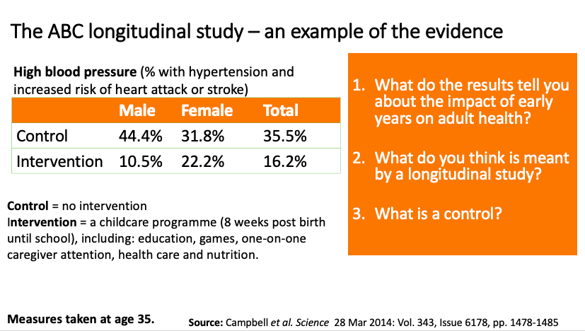
Lesson 3 differentiation

Slide 33
Check your understanding
At what age do you think a child's brain is developing fastest?
Start of pregnancy to 2 years
3 - 5 years
6 - 10 years
11 - 15 years
Develops evenly throughout childhood until adulthood
I don’t know.
When is the brain most sensitive to experiences?
0 - 5 years
0 - 5 years and 11 - 25 years
0 - 5 years and 10 - 15 years
0 - 25 years
Throughout life
I don’t know.
Which of the following has/ have an impact on an individual's resilience? Select all the answers that are correct.
Their genes.
The number of people that can support them.
The number of difficult situations they experience.
Having a safe learning environment.
I don't know.

Slide 34
Check your understanding
At what age do you think a child's brain is developing fastest?
Start of pregnancy to 2 years
3 - 5 years
6 - 10 years
11 - 15 years
Develops evenly throughout childhood until adulthood
I don’t know.
When is the brain most sensitive to experiences?
0 - 5 years
0 - 5 years and 11 - 25 years
0 - 5 years and 10 - 15 years
0 - 25 years
Throughout life
I don’t know.
Which of the following has/ have an impact on an individual's resilience? Select all the answers that are correct.
Their genes.
The number of people that can support them.
The number of difficult situations they experience.
Having a safe learning environment.
I don't know.

Slide 35
Additional activities
Lesson two activities
Epigenetics
Attachment theory
Stress and the brain

Slide 36
Safeguarding

Slide 37
Safeguarding
Some students may have had difficult experiences in their early years.
The curriculum materials avoid this topic to reduce the risk of possible triggers for students.
However, if a student does express issues around the lesson content:
  Acknowledge their thoughts and feelings around the content,
  Reassure the student that many factors influence individual outcomes,
  Refer to and follow your school’s safeguarding policies and procedures,
  Signpost where a student can go for additional support in school (if needed).
Further information on safeguarding is available in the teacher pack.

Slide 38
Teacher pack

Slide 39


Teacher pack
Learning objectives
Content
Vocabulary
Full lesson plan, with adaptations
Video links and worksheets
Pre-recorded lessons
Links to other curriculum areas
Additional reading and resources
Questions in the student quiz and staff feedback
Training video and slide deck
https://www.psych.ox.ac.uk/research/seen

Slide 40

Questions
https://www.psych.ox.ac.uk/research/seen
seen@psych.ox.ac.uk

